Slide 1
Academy, Fountain Park, Lewis Place Place, Vandeventer
Monthly Crime report: November 2019 Washington University Medical Center

Slide 2
Academy: Summary Notes
12 total crimes in November 2019
-40% change compared to November 2018 (20 total crimes)
1 crime(s) against persons in November 2019
-80% change compared to November 2018 (5 crimes against persons)
204 total crimes in 2019
920% change compared to this time in 2018 (20 total crimes)
62 crime(s) against persons in 2019
1 140% change compared to this time in 2018 (5 crimes against persons)

Slide 3
Academy: Year to Year Comparison
Part 1 Crimes | Jan | Feb | Mar | Apr | May | Jun | Jul | Aug | Sep | Oct | Nov | Dec | Total
0 | 0 | 0 | 0 | 0 | 0 | 0 | 0 | 0 | 0 | 0 | 0 | 0 | 0
Aggravated Assault | 0 | 0 | 0 | 0 | 0 | 0 | 0 | 0 | 0 | 0 | 2 | 3 | 5
Arson | 0 | 0 | 0 | 0 | 0 | 0 | 0 | 0 | 0 | 0 | 1 | 0 | 1
Burgalry | 0 | 0 | 0 | 0 | 0 | 0 | 0 | 0 | 0 | 0 | 4 | 2 | 6
Homicide | 0 | 0 | 0 | 0 | 0 | 0 | 0 | 0 | 0 | 0 | 0 | 0 | 0
Larceny | 0 | 0 | 0 | 0 | 0 | 0 | 0 | 0 | 0 | 0 | 7 | 6 | 13
Motor Vehicle Theft | 0 | 0 | 0 | 0 | 0 | 0 | 0 | 0 | 0 | 0 | 3 | 2 | 5
Robbery | 0 | 0 | 0 | 0 | 0 | 0 | 0 | 0 | 0 | 0 | 3 | 5 | 8
Total | 0 | 0 | 0 | 0 | 0 | 0 | 0 | 0 | 0 | 0 | 20 | 18 | 38
Part 1 Crimes | Jan | Feb | Mar | Apr | May | Jun | Jul | Aug | Sep | Oct | Nov | Total
Aggravated Assault | 8 | 7 | 4 | 3 | 2 | 4 | 3 | 5 | 8 | 2 | 0 | 46
Arson | 0 | 1 | 0 | 0 | 0 | 0 | 1 | 0 | 0 | 4 | 0 | 6
Burgalry | 5 | 3 | 1 | 2 | 1 | 1 | 3 | 4 | 1 | 3 | 0 | 24
Homicide | 0 | 0 | 0 | 0 | 0 | 0 | 0 | 1 | 0 | 1 | 0 | 2
Larceny | 7 | 4 | 5 | 8 | 7 | 8 | 9 | 10 | 11 | 11 | 9 | 89
Motor Vehicle Theft | 2 | 1 | 0 | 1 | 1 | 4 | 4 | 2 | 1 | 3 | 2 | 21
Robbery | 0 | 1 | 2 | 2 | 2 | 0 | 0 | 5 | 2 | 1 | 1 | 16
Total | 22 | 17 | 12 | 16 | 13 | 17 | 20 | 27 | 23 | 25 | 12 | 204

Slide 4
Academy: Summary Tables
Part 1 Crimes | Number of Crimes
Larceny | 9
Motor Vehicle Theft | 2
Robbery | 1
Total | 12
Day of the Week | Number of Crimes
Sun | 2
Mon | 1
Tue | 0
Wed | 2
Thu | 2
Fri | 4
Sat | 1
Total | 12
Crimes Against Persons | Number of Crimes
FALSE | 11
TRUE | 1
Total | 12
Time of Day | Number of Crimes
Day | 10
Night | 2
Total | 12

Slide 5
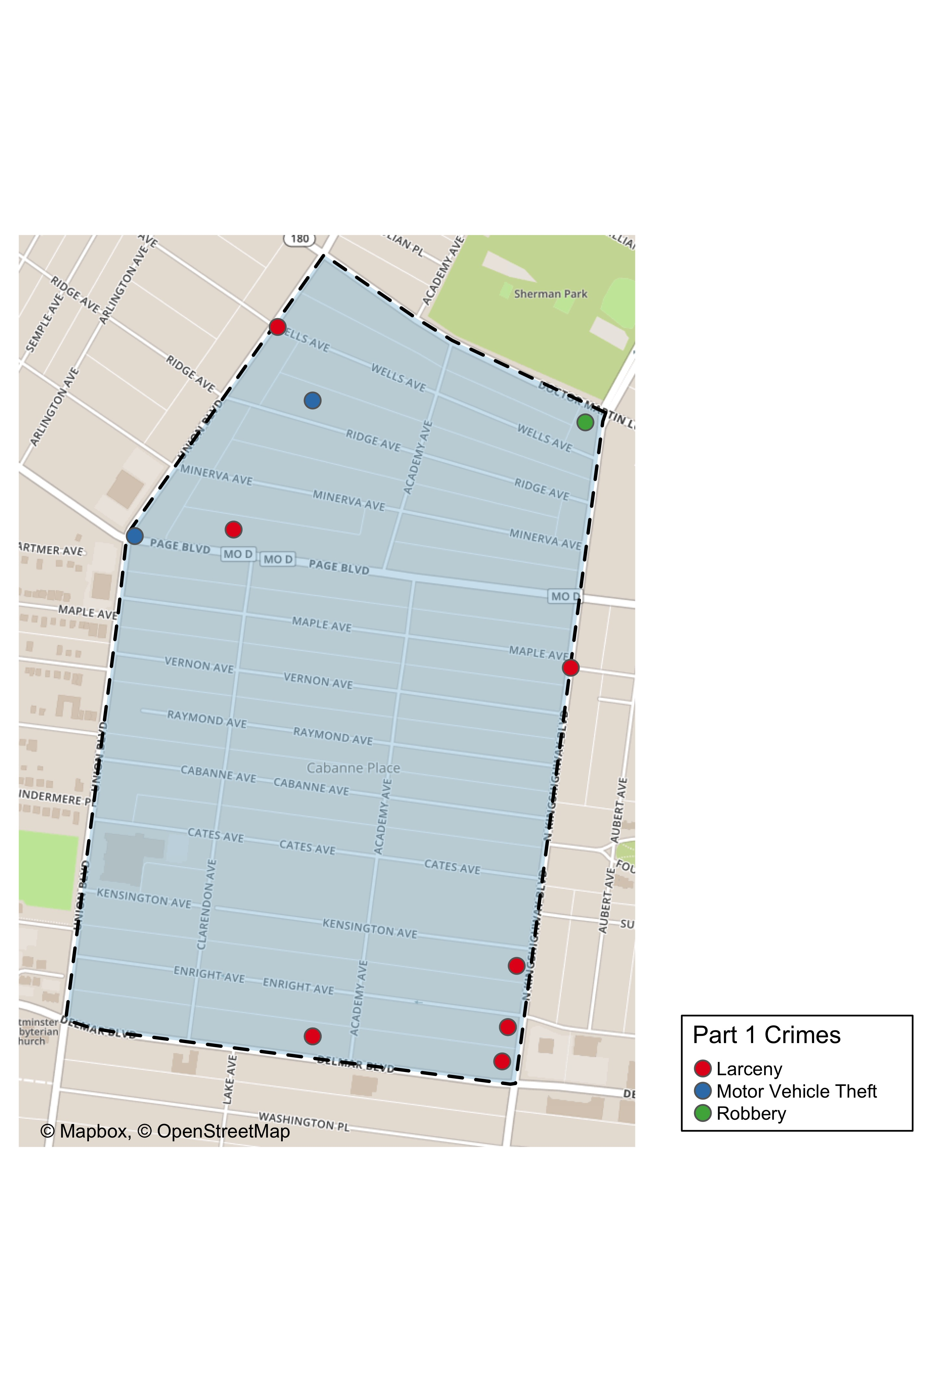
Academy: Total Crime Map

Slide 6
Fountain Park: Summary Notes
9 total crimes in November 2019
-18% change compared to November 2018 (11 total crimes)
4 crime(s) against persons in November 2019
33% change compared to November 2018 (3 crimes against persons)
159 total crimes in 2019
1 345% change compared to this time in 2018 (11 total crimes)
66 crime(s) against persons in 2019
2 100% change compared to this time in 2018 (3 crimes against persons)

Slide 7
Fountain Park: Year to Year Comparison
Part 1 Crimes | Jan | Feb | Mar | Apr | May | Jun | Jul | Aug | Sep | Oct | Nov | Dec | Total
0 | 0 | 0 | 0 | 0 | 0 | 0 | 0 | 0 | 0 | 0 | 0 | 0 | 0
Aggravated Assault | 0 | 0 | 0 | 0 | 0 | 0 | 0 | 0 | 0 | 0 | 0 | 4 | 4
Arson | 0 | 0 | 0 | 0 | 0 | 0 | 0 | 0 | 0 | 0 | 0 | 1 | 1
Burgalry | 0 | 0 | 0 | 0 | 0 | 0 | 0 | 0 | 0 | 0 | 2 | 0 | 2
Homicide | 0 | 0 | 0 | 0 | 0 | 0 | 0 | 0 | 0 | 0 | 0 | 2 | 2
Larceny | 0 | 0 | 0 | 0 | 0 | 0 | 0 | 0 | 0 | 0 | 6 | 3 | 9
Motor Vehicle Theft | 0 | 0 | 0 | 0 | 0 | 0 | 0 | 0 | 0 | 0 | 0 | 3 | 3
Robbery | 0 | 0 | 0 | 0 | 0 | 0 | 0 | 0 | 0 | 0 | 3 | 1 | 4
Total | 0 | 0 | 0 | 0 | 0 | 0 | 0 | 0 | 0 | 0 | 11 | 14 | 25
Part 1 Crimes | Jan | Feb | Mar | Apr | May | Jun | Jul | Aug | Sep | Oct | Nov | Total
Aggravated Assault | 5 | 3 | 11 | 3 | 0 | 3 | 8 | 3 | 7 | 5 | 3 | 51
Arson | 0 | 0 | 0 | 1 | 0 | 0 | 0 | 1 | 0 | 0 | 0 | 2
Burgalry | 3 | 2 | 1 | 0 | 2 | 0 | 2 | 2 | 2 | 0 | 2 | 16
Homicide | 0 | 1 | 1 | 0 | 0 | 0 | 1 | 0 | 0 | 1 | 0 | 4
Larceny | 4 | 5 | 6 | 5 | 2 | 5 | 6 | 7 | 10 | 3 | 3 | 56
Motor Vehicle Theft | 3 | 0 | 4 | 1 | 0 | 2 | 2 | 0 | 2 | 1 | 0 | 15
Robbery | 1 | 0 | 0 | 2 | 0 | 3 | 1 | 5 | 0 | 2 | 1 | 15
Total | 16 | 11 | 23 | 12 | 4 | 13 | 20 | 18 | 21 | 12 | 9 | 159

Slide 8
Fountain Park: Summary Tables
Part 1 Crimes | Number of Crimes
Aggravated Assault | 3
Burgalry | 2
Larceny | 3
Robbery | 1
Total | 9
Day of the Week | Number of Crimes
Sun | 1
Mon | 2
Tue | 4
Wed | 0
Thu | 1
Fri | 1
Sat | 0
Total | 9
Crimes Against Persons | Number of Crimes
FALSE | 5
TRUE | 4
Total | 9
Time of Day | Number of Crimes
Day | 9
Total | 9

Slide 9
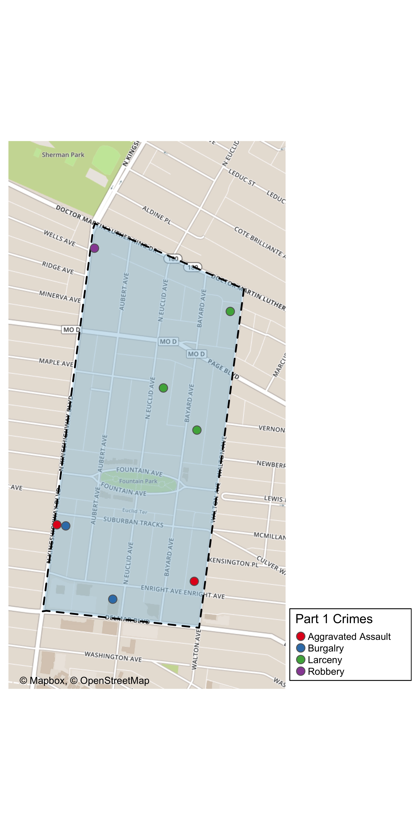
Fountain Park: Total Crime Map

Slide 10
Summary Notes: Lewis Place
5 total crimes in November 2019
-55% change compared to November 2018 (11 total crimes)
0 crime(s) against persons in November 2019
-100% change compared to November 2018 (2 crimes against persons)
112 total crimes in 2019
918% change compared to this time in 2018 (11 total crimes)
37 crime(s) against persons in 2019
1 750% change compared to this time in 2018 (2 crimes against persons)

Slide 11
Lewis Place: Year to Year Comparison
Part 1 Crimes | Jan | Feb | Mar | Apr | May | Jun | Jul | Aug | Sep | Oct | Nov | Dec | Total
0 | 0 | 0 | 0 | 0 | 0 | 0 | 0 | 0 | 0 | 0 | 0 | 0 | 0
Aggravated Assault | 0 | 0 | 0 | 0 | 0 | 0 | 0 | 0 | 0 | 0 | 0 | 6 | 6
Arson | 0 | 0 | 0 | 0 | 0 | 0 | 0 | 0 | 0 | 0 | 0 | 0 | 0
Burgalry | 0 | 0 | 0 | 0 | 0 | 0 | 0 | 0 | 0 | 0 | 2 | 2 | 4
Homicide | 0 | 0 | 0 | 0 | 0 | 0 | 0 | 0 | 0 | 0 | 0 | 0 | 0
Larceny | 0 | 0 | 0 | 0 | 0 | 0 | 0 | 0 | 0 | 0 | 4 | 3 | 7
Motor Vehicle Theft | 0 | 0 | 0 | 0 | 0 | 0 | 0 | 0 | 0 | 0 | 3 | 0 | 3
Robbery | 0 | 0 | 0 | 0 | 0 | 0 | 0 | 0 | 0 | 0 | 2 | 0 | 2
Total | 0 | 0 | 0 | 0 | 0 | 0 | 0 | 0 | 0 | 0 | 11 | 11 | 22
Part 1 Crimes | Jan | Feb | Mar | Apr | May | Jun | Jul | Aug | Sep | Oct | Nov | Total
Aggravated Assault | 0 | 3 | 2 | 3 | 13 | 1 | 2 | 0 | 5 | 4 | 0 | 33
Arson | 0 | 1 | 0 | 0 | 1 | 0 | 0 | 0 | 0 | 0 | 0 | 2
Burgalry | 0 | 1 | 0 | 1 | 0 | 1 | 2 | 4 | 0 | 2 | 4 | 15
Homicide | 0 | 0 | 1 | 1 | 2 | 0 | 3 | 0 | 0 | 0 | 0 | 7
Larceny | 5 | 2 | 3 | 6 | 3 | 5 | 4 | 2 | 2 | 5 | 0 | 37
Motor Vehicle Theft | 0 | 1 | 2 | 1 | 1 | 1 | 0 | 1 | 5 | 1 | 1 | 14
Robbery | 0 | 0 | 0 | 0 | 1 | 0 | 1 | 1 | 1 | 0 | 0 | 4
Total | 5 | 8 | 8 | 12 | 21 | 8 | 12 | 8 | 13 | 12 | 5 | 112

Slide 12
Lewis Place: Summary Tables
Part 1 Crimes | Number of Crimes
Burgalry | 4
Motor Vehicle Theft | 1
Total | 5
Day of the Week | Number of Crimes
Sun | 0
Mon | 0
Tue | 1
Wed | 0
Thu | 1
Fri | 1
Sat | 2
Total | 5
Crimes Against Persons | Number of Crimes
FALSE | 5
Total | 5
Time of Day | Number of Crimes
Day | 5
Total | 5

Slide 13
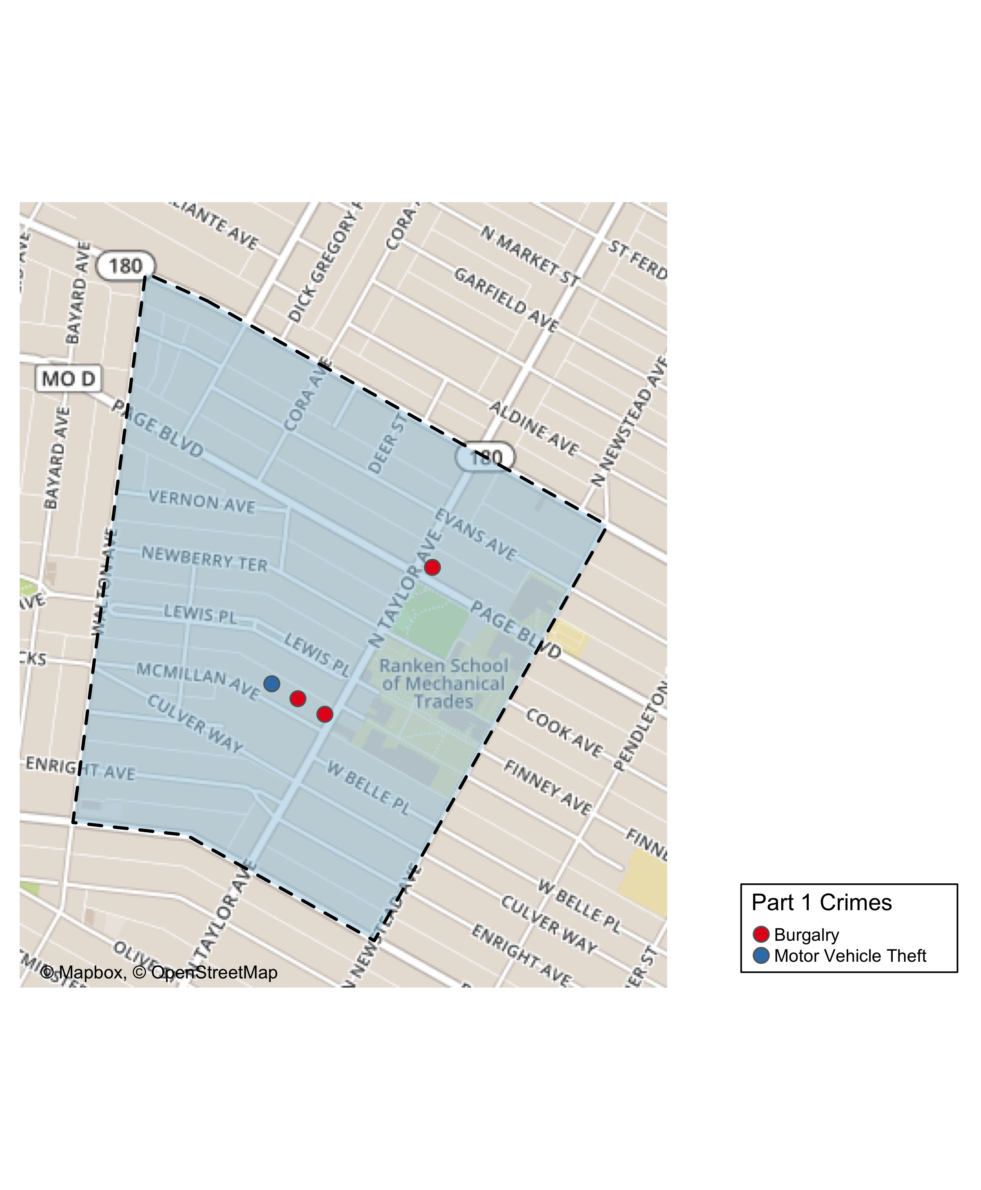
Lewis Place: Total Crime Map

Slide 14
Vandeventer: Summary Notes
15 total crimes in November 2019
67% change compared to November 2018 (9 total crimes)
1 crime(s) against persons in November 2019
-80% change compared to November 2018 (5 crimes against persons)
162 total crimes in 2019
1 700% change compared to this time in 2018 (9 total crimes)
32 crime(s) against persons in 2019
540% change compared to this time in 2018 (5 crimes against persons)

Slide 15
Vandeventer: Year to Year Comparison
Part 1 Crimes | Jan | Feb | Mar | Apr | May | Jun | Jul | Aug | Sep | Oct | Nov | Dec | Total
0 | 0 | 0 | 0 | 0 | 0 | 0 | 0 | 0 | 0 | 0 | 0 | 0 | 0
Aggravated Assault | 0 | 0 | 0 | 0 | 0 | 0 | 0 | 0 | 0 | 0 | 4 | 1 | 5
Arson | 0 | 0 | 0 | 0 | 0 | 0 | 0 | 0 | 0 | 0 | 0 | 0 | 0
Burgalry | 0 | 0 | 0 | 0 | 0 | 0 | 0 | 0 | 0 | 0 | 0 | 3 | 3
Homicide | 0 | 0 | 0 | 0 | 0 | 0 | 0 | 0 | 0 | 0 | 0 | 0 | 0
Larceny | 0 | 0 | 0 | 0 | 0 | 0 | 0 | 0 | 0 | 0 | 2 | 5 | 7
Motor Vehicle Theft | 0 | 0 | 0 | 0 | 0 | 0 | 0 | 0 | 0 | 0 | 2 | 2 | 4
Robbery | 0 | 0 | 0 | 0 | 0 | 0 | 0 | 0 | 0 | 0 | 1 | 0 | 1
Total | 0 | 0 | 0 | 0 | 0 | 0 | 0 | 0 | 0 | 0 | 9 | 11 | 20
Part 1 Crimes | Jan | Feb | Mar | Apr | May | Jun | Jul | Aug | Sep | Oct | Nov | Total
Aggravated Assault | 0 | 2 | 6 | 2 | 4 | 0 | 1 | 3 | 1 | 3 | 0 | 22
Arson | 0 | 1 | 0 | 0 | 0 | 0 | 0 | 0 | 0 | 0 | 0 | 1
Burgalry | 1 | 2 | 5 | 3 | 5 | 4 | 3 | 1 | 2 | 3 | 5 | 34
Homicide | 0 | 0 | 1 | 0 | 0 | 0 | 0 | 0 | 0 | 0 | 0 | 1
Larceny | 5 | 2 | 3 | 5 | 4 | 5 | 14 | 13 | 17 | 6 | 8 | 82
Motor Vehicle Theft | 0 | 2 | 1 | 0 | 0 | 2 | 1 | 3 | 1 | 1 | 1 | 12
Robbery | 0 | 0 | 1 | 0 | 1 | 4 | 0 | 0 | 1 | 2 | 1 | 10
Total | 6 | 9 | 17 | 10 | 14 | 15 | 19 | 20 | 22 | 15 | 15 | 162

Slide 16
Vandeventer: Summary Tables
Part 1 Crimes | Number of Crimes
Burgalry | 5
Larceny | 8
Motor Vehicle Theft | 1
Robbery | 1
Total | 15
Day of the Week | Number of Crimes
Sun | 2
Mon | 2
Tue | 3
Wed | 3
Thu | 3
Fri | 2
Sat | 0
Total | 15
Crimes Against Persons | Number of Crimes
FALSE | 14
TRUE | 1
Total | 15
Time of Day | Number of Crimes
Day | 15
Total | 15

Slide 17
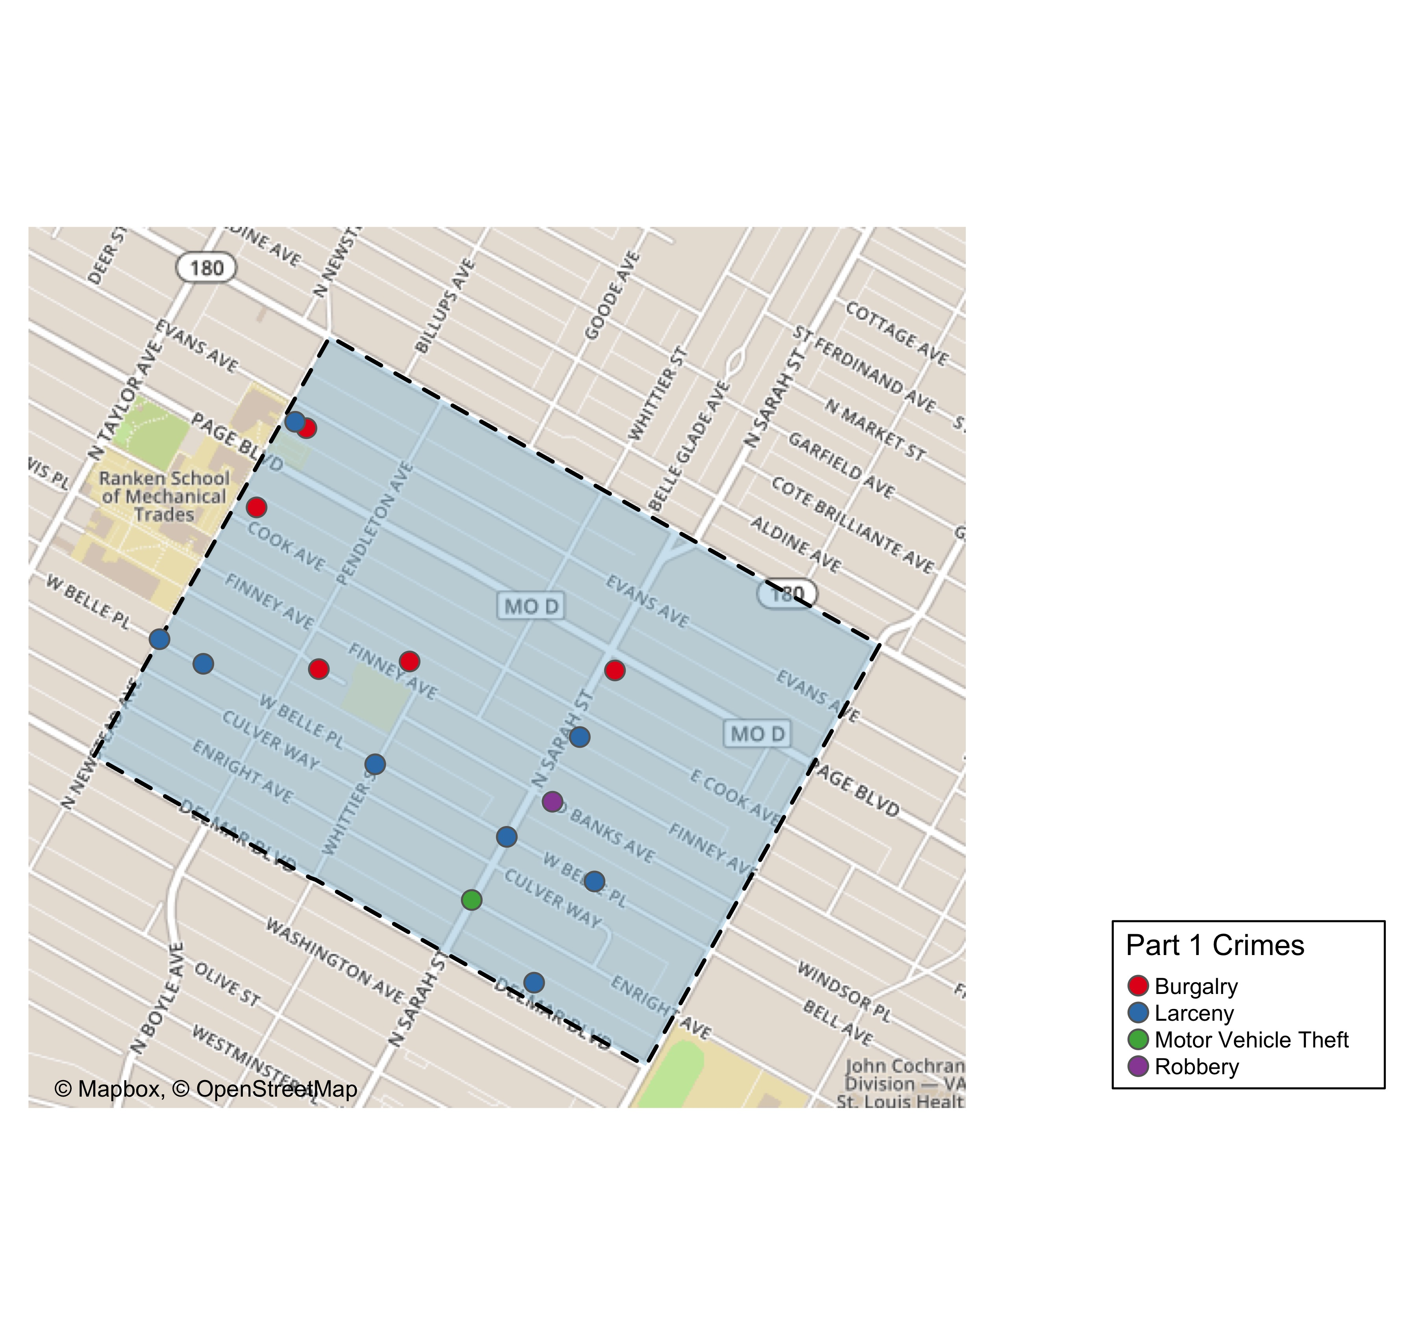
Vandeventer: Total Crime Map

Slide 18
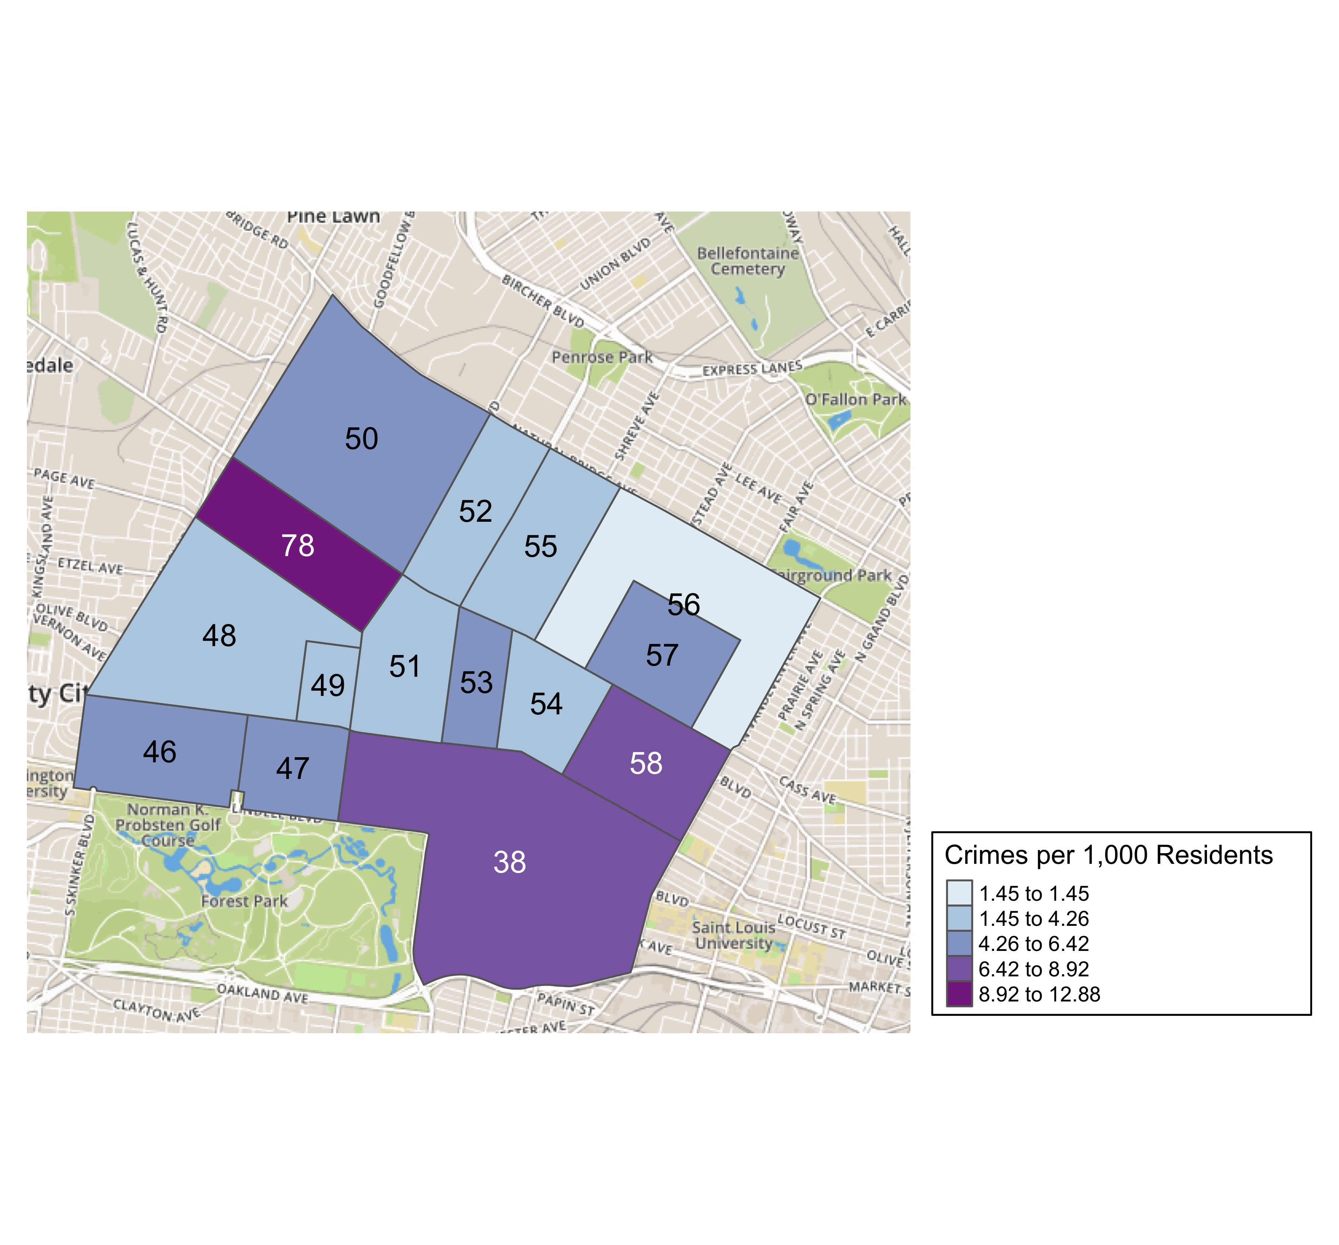
District 5: Crime Rates Map

Slide 19
District 5: Density Map Explanation
There are 15 neighborhoods in District 5.
The minimum number of crimes in one neighborhood was 3 (Visitation Park)
The maximum number of crimes in one neighborhood was 117 (Central West End)
The mean number of crimes in one neighborhood was 23.27
The minimum rate of crimes in one neighborhood was 1.45 (Greater Ville)
The maximum rate of crimes in one neighborhood was 12.88 (Hamilton Heights)
The mean rate of crimes in one neighborhood was 5.49

Slide 20
Academy: Neighborhood Detail
Appendix 1

Slide 21
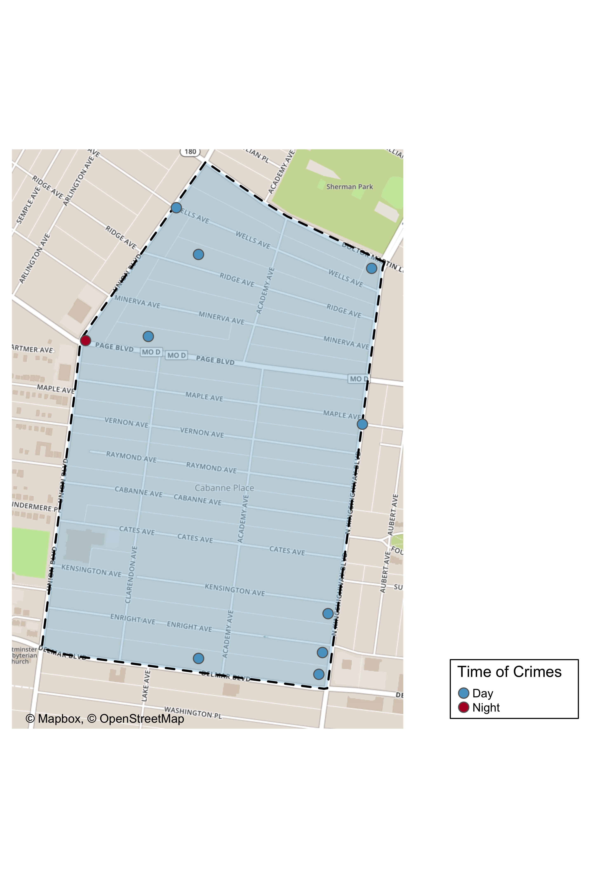
Academy: Time of Crimes Map

Slide 22
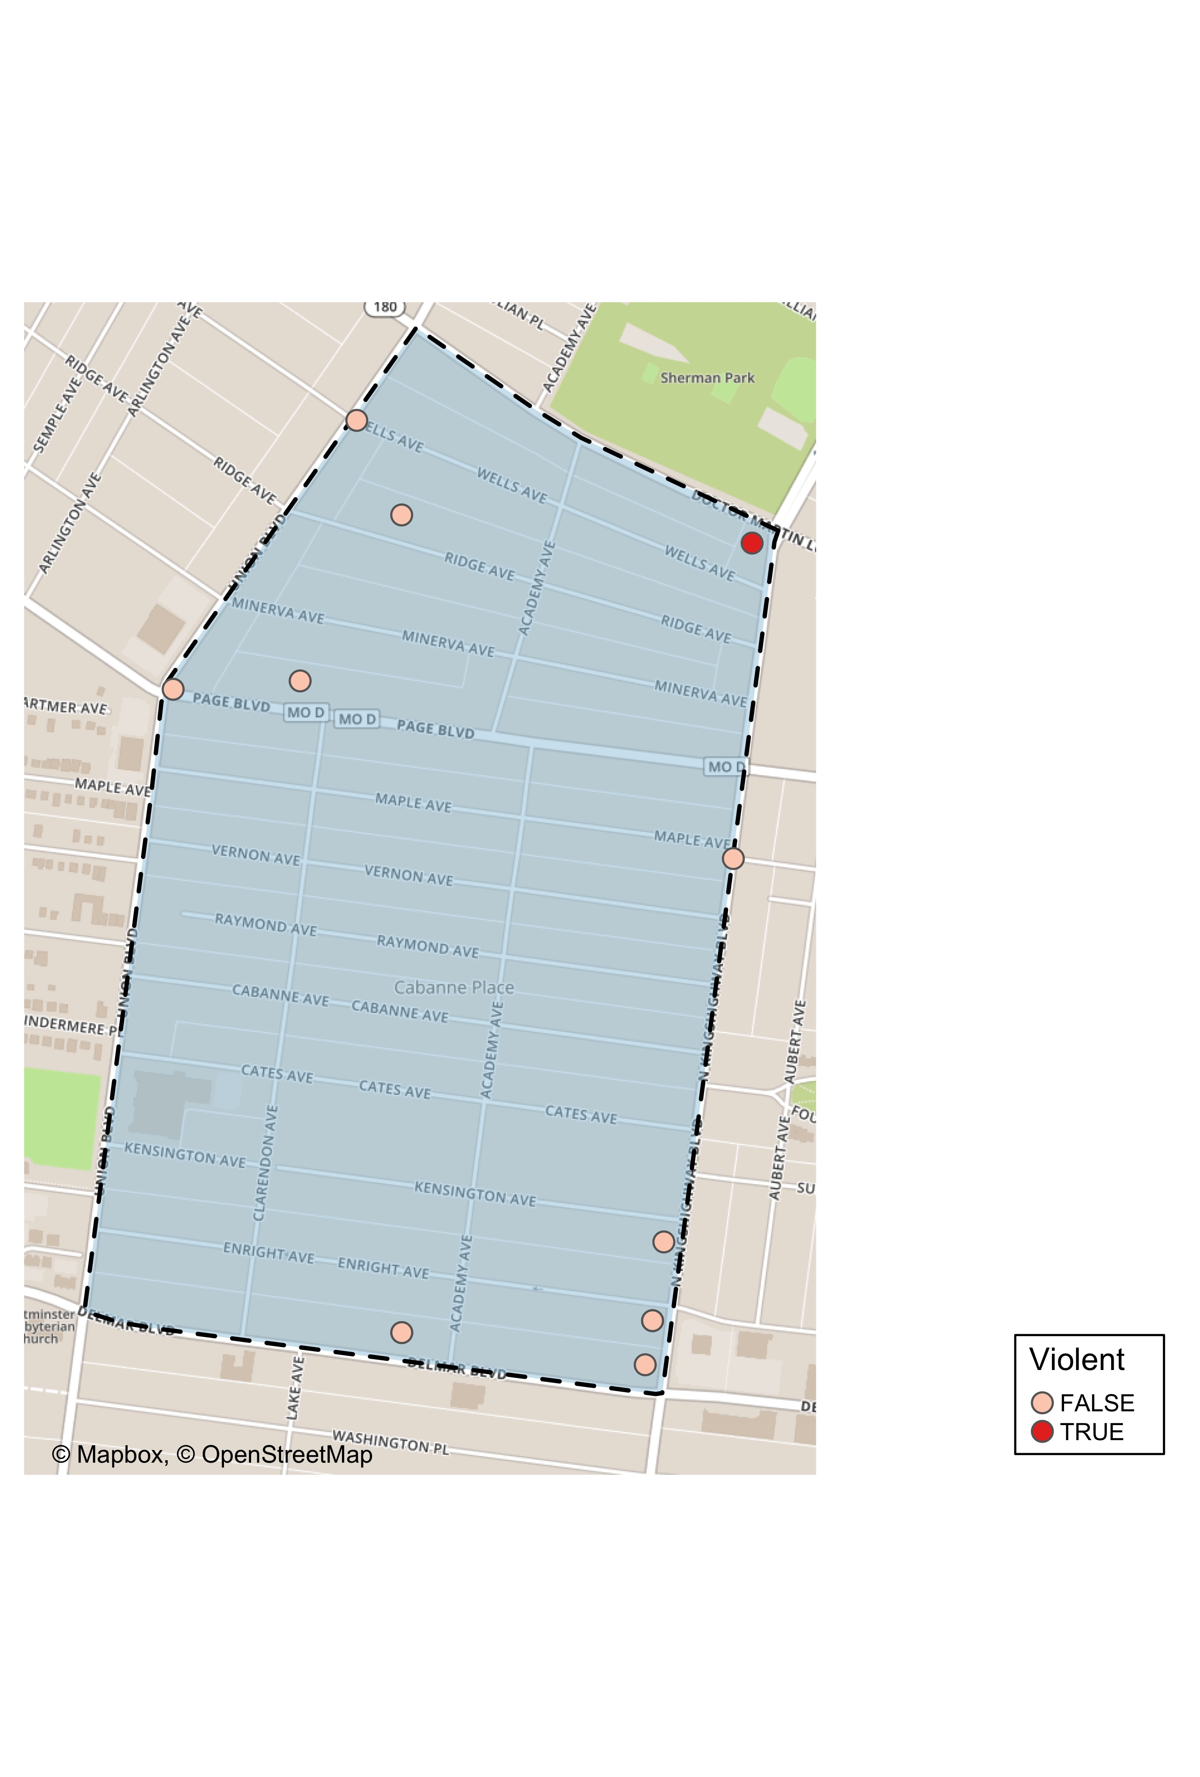
Academy: Violent Crime Map

Slide 23
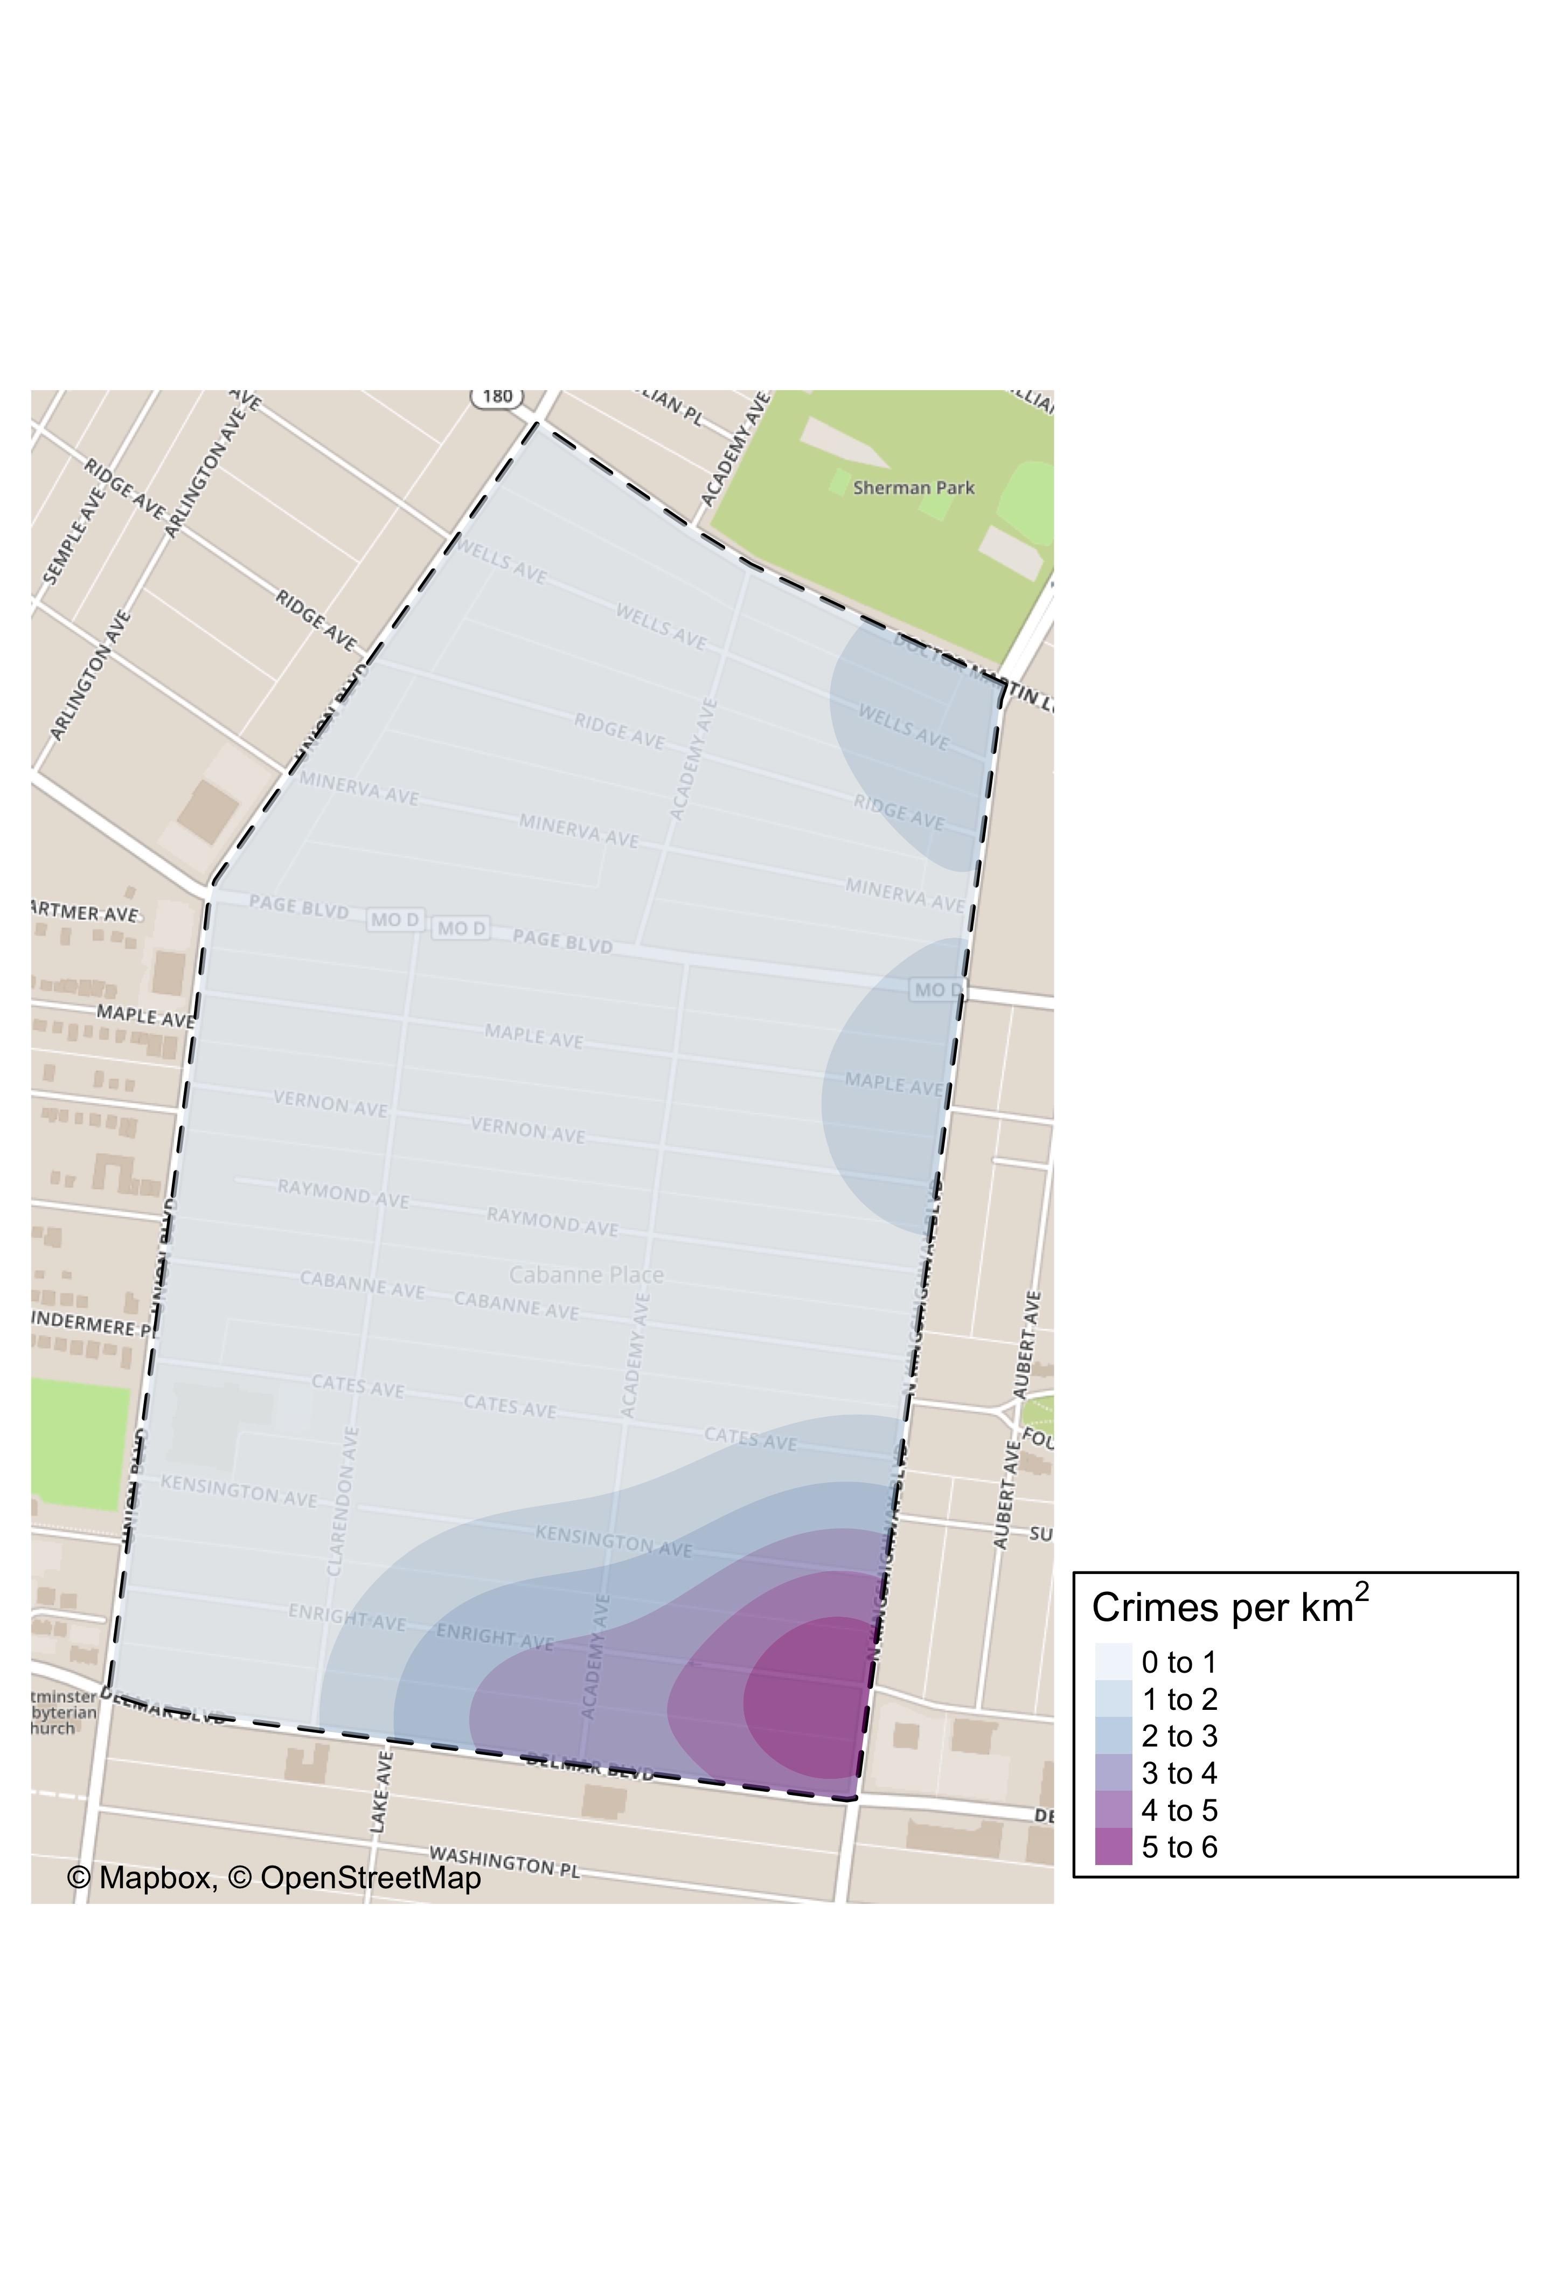
Academy: Crime Density Map

Slide 24
Academy: Larceny Breakdown
Day of the Week | Number of Crimes
Sun | 1
Mon | 1
Wed | 2
Thu | 1
Fri | 3
Sat | 1
Total | 9
Time of Day | Number of Crimes
Day | 8
Night | 1
Total | 9
Type of Larceny | Number of Crimes
All Other | 1
From Building | 2
From Motor Vehicle | 1
Motor Vehicle Parts | 2
Shoplifting | 3
Total | 9
Monetary | Number of Crimes
$500 - $24,999 | 1
Under $500 | 8
Total | 9

Slide 25
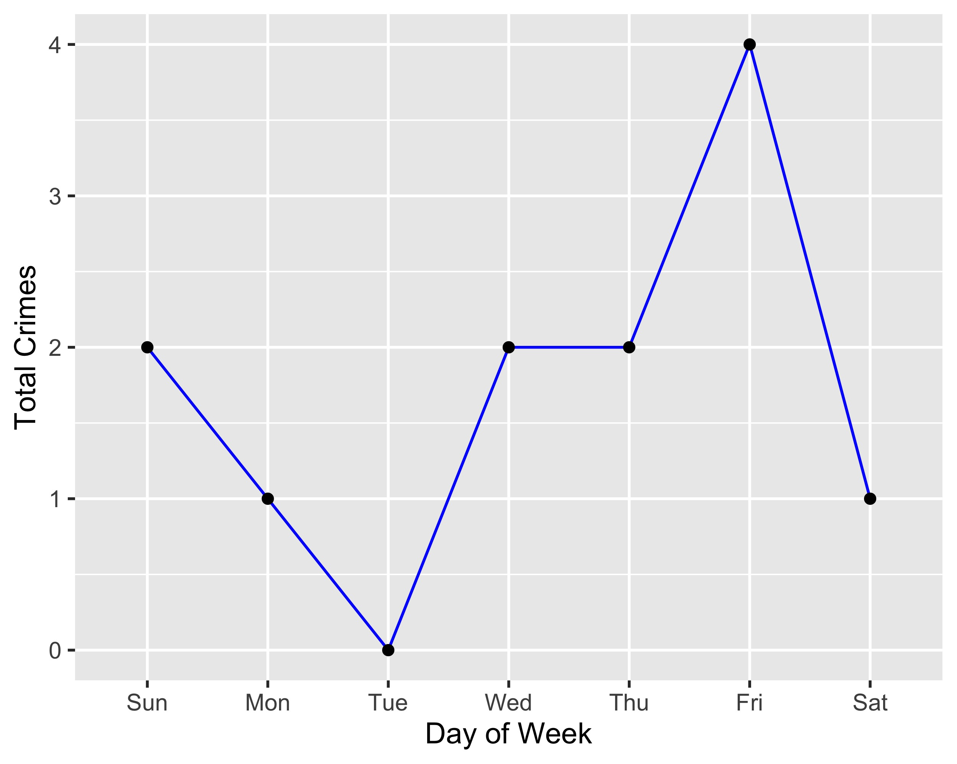
Academy: Total Crimes by Days of the Week

Slide 26
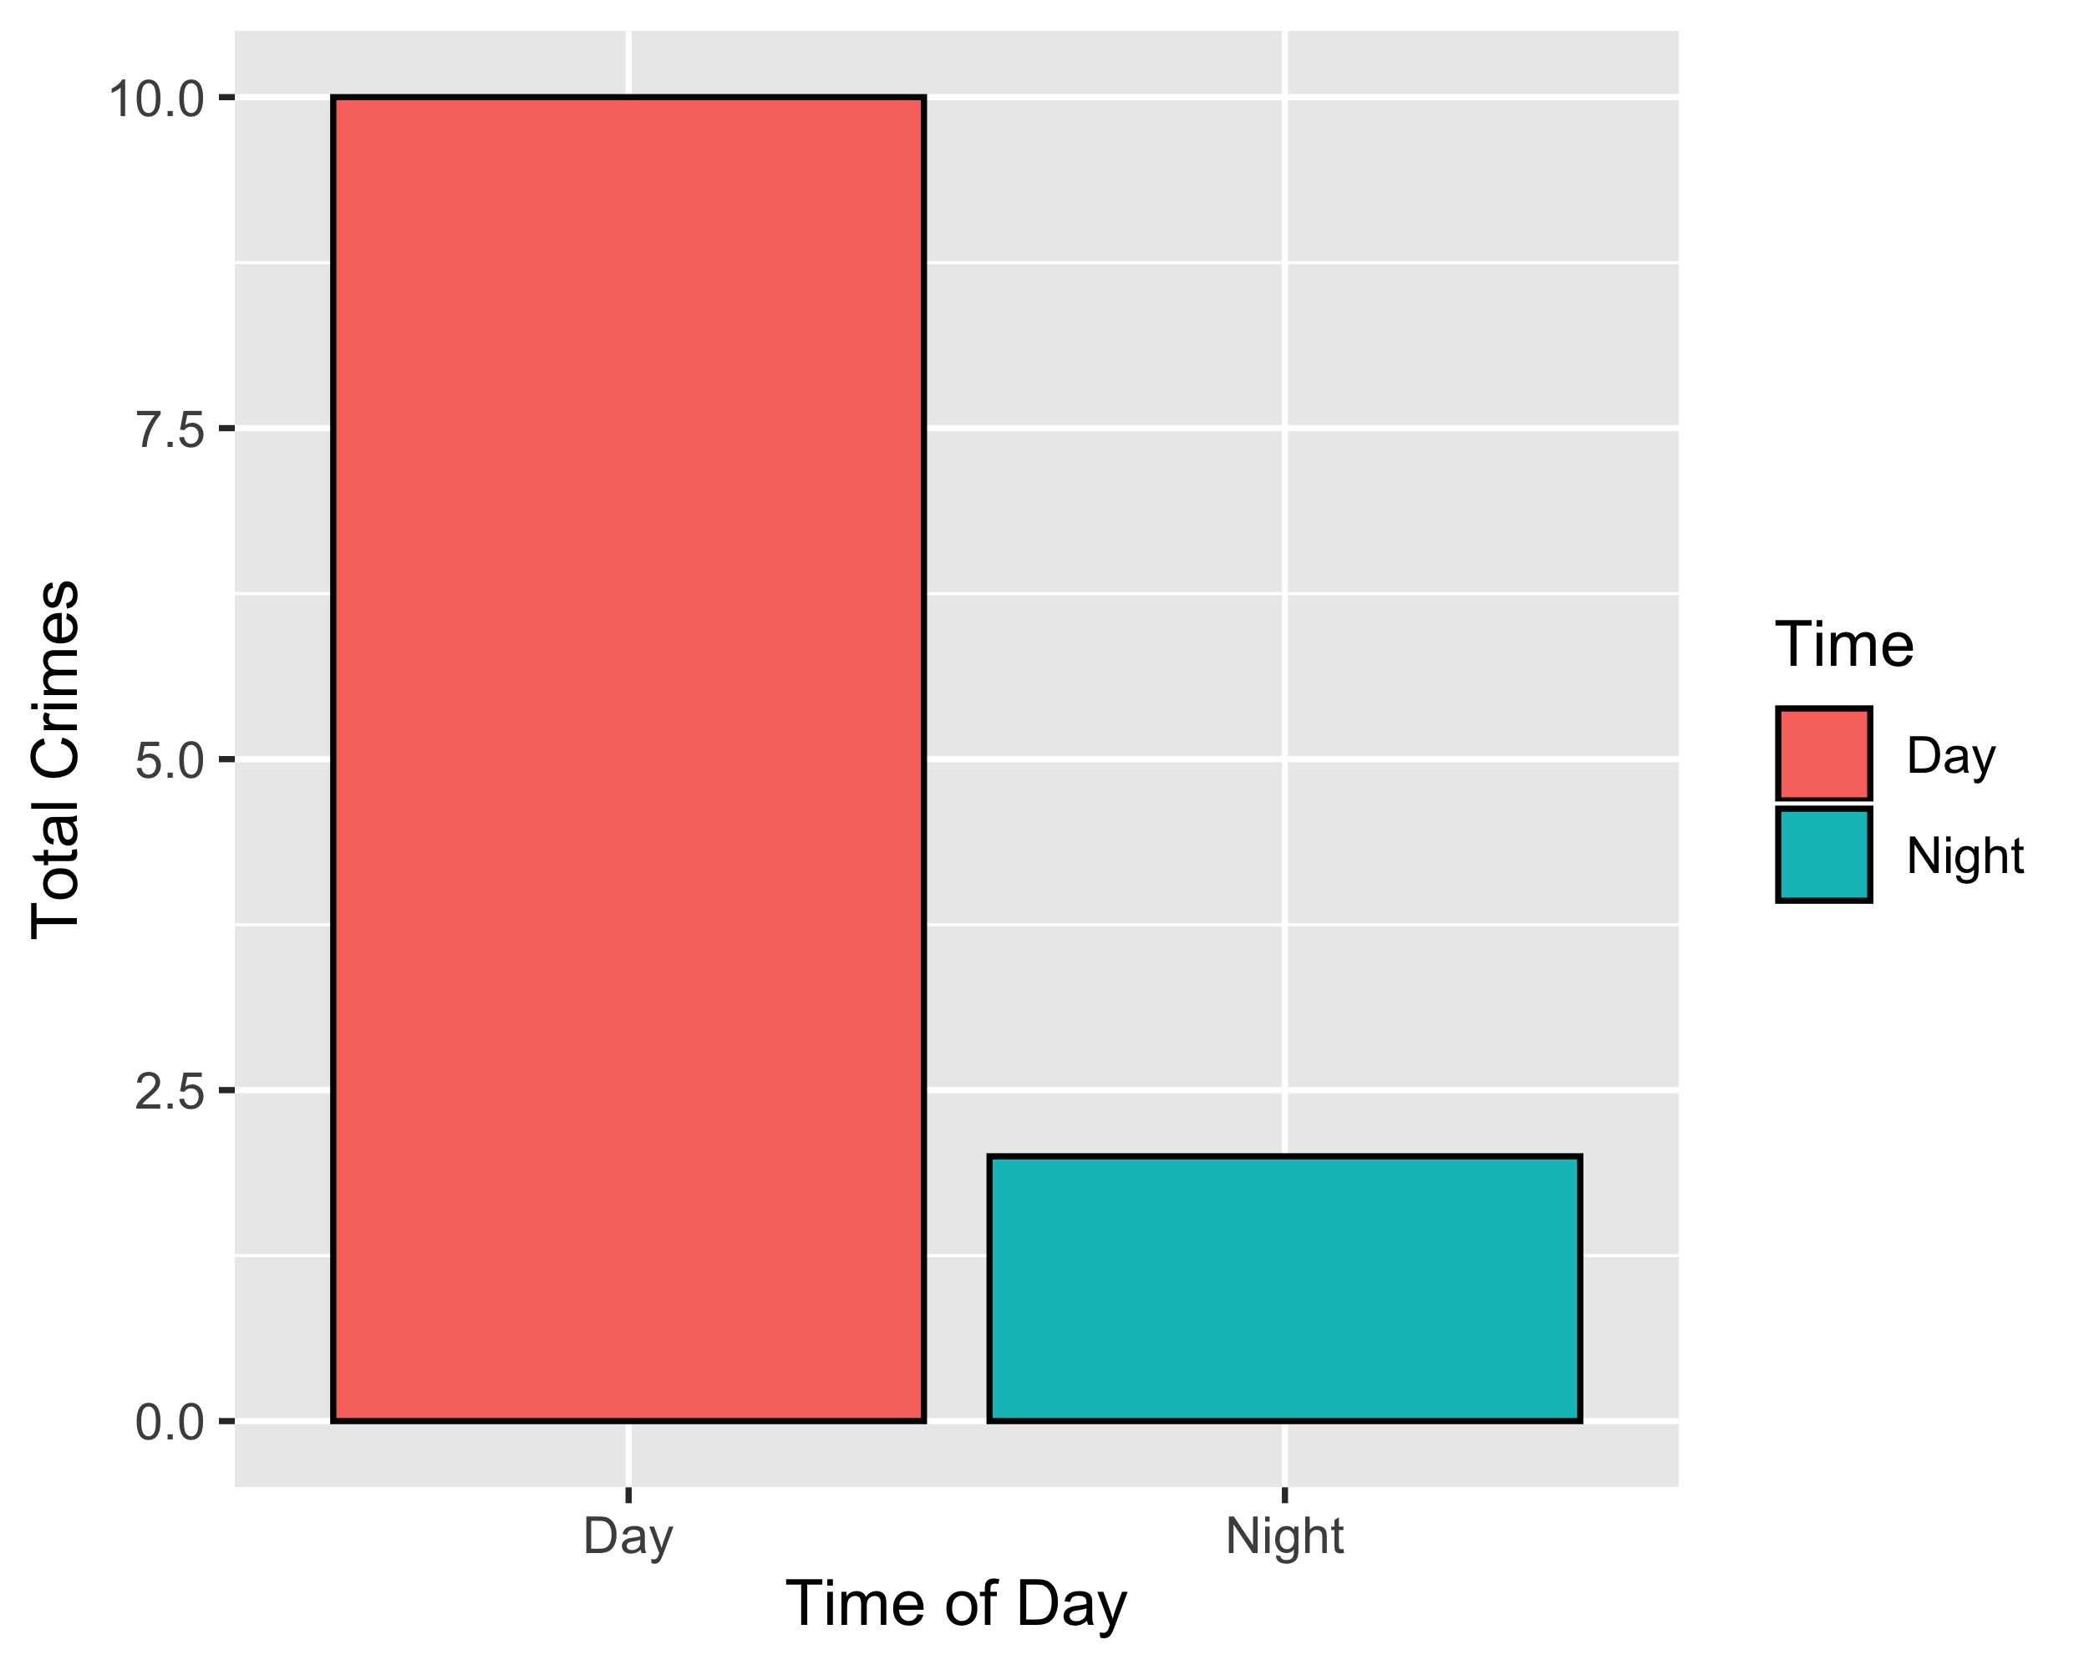
Academy: Crimes by Time of Day

Slide 27
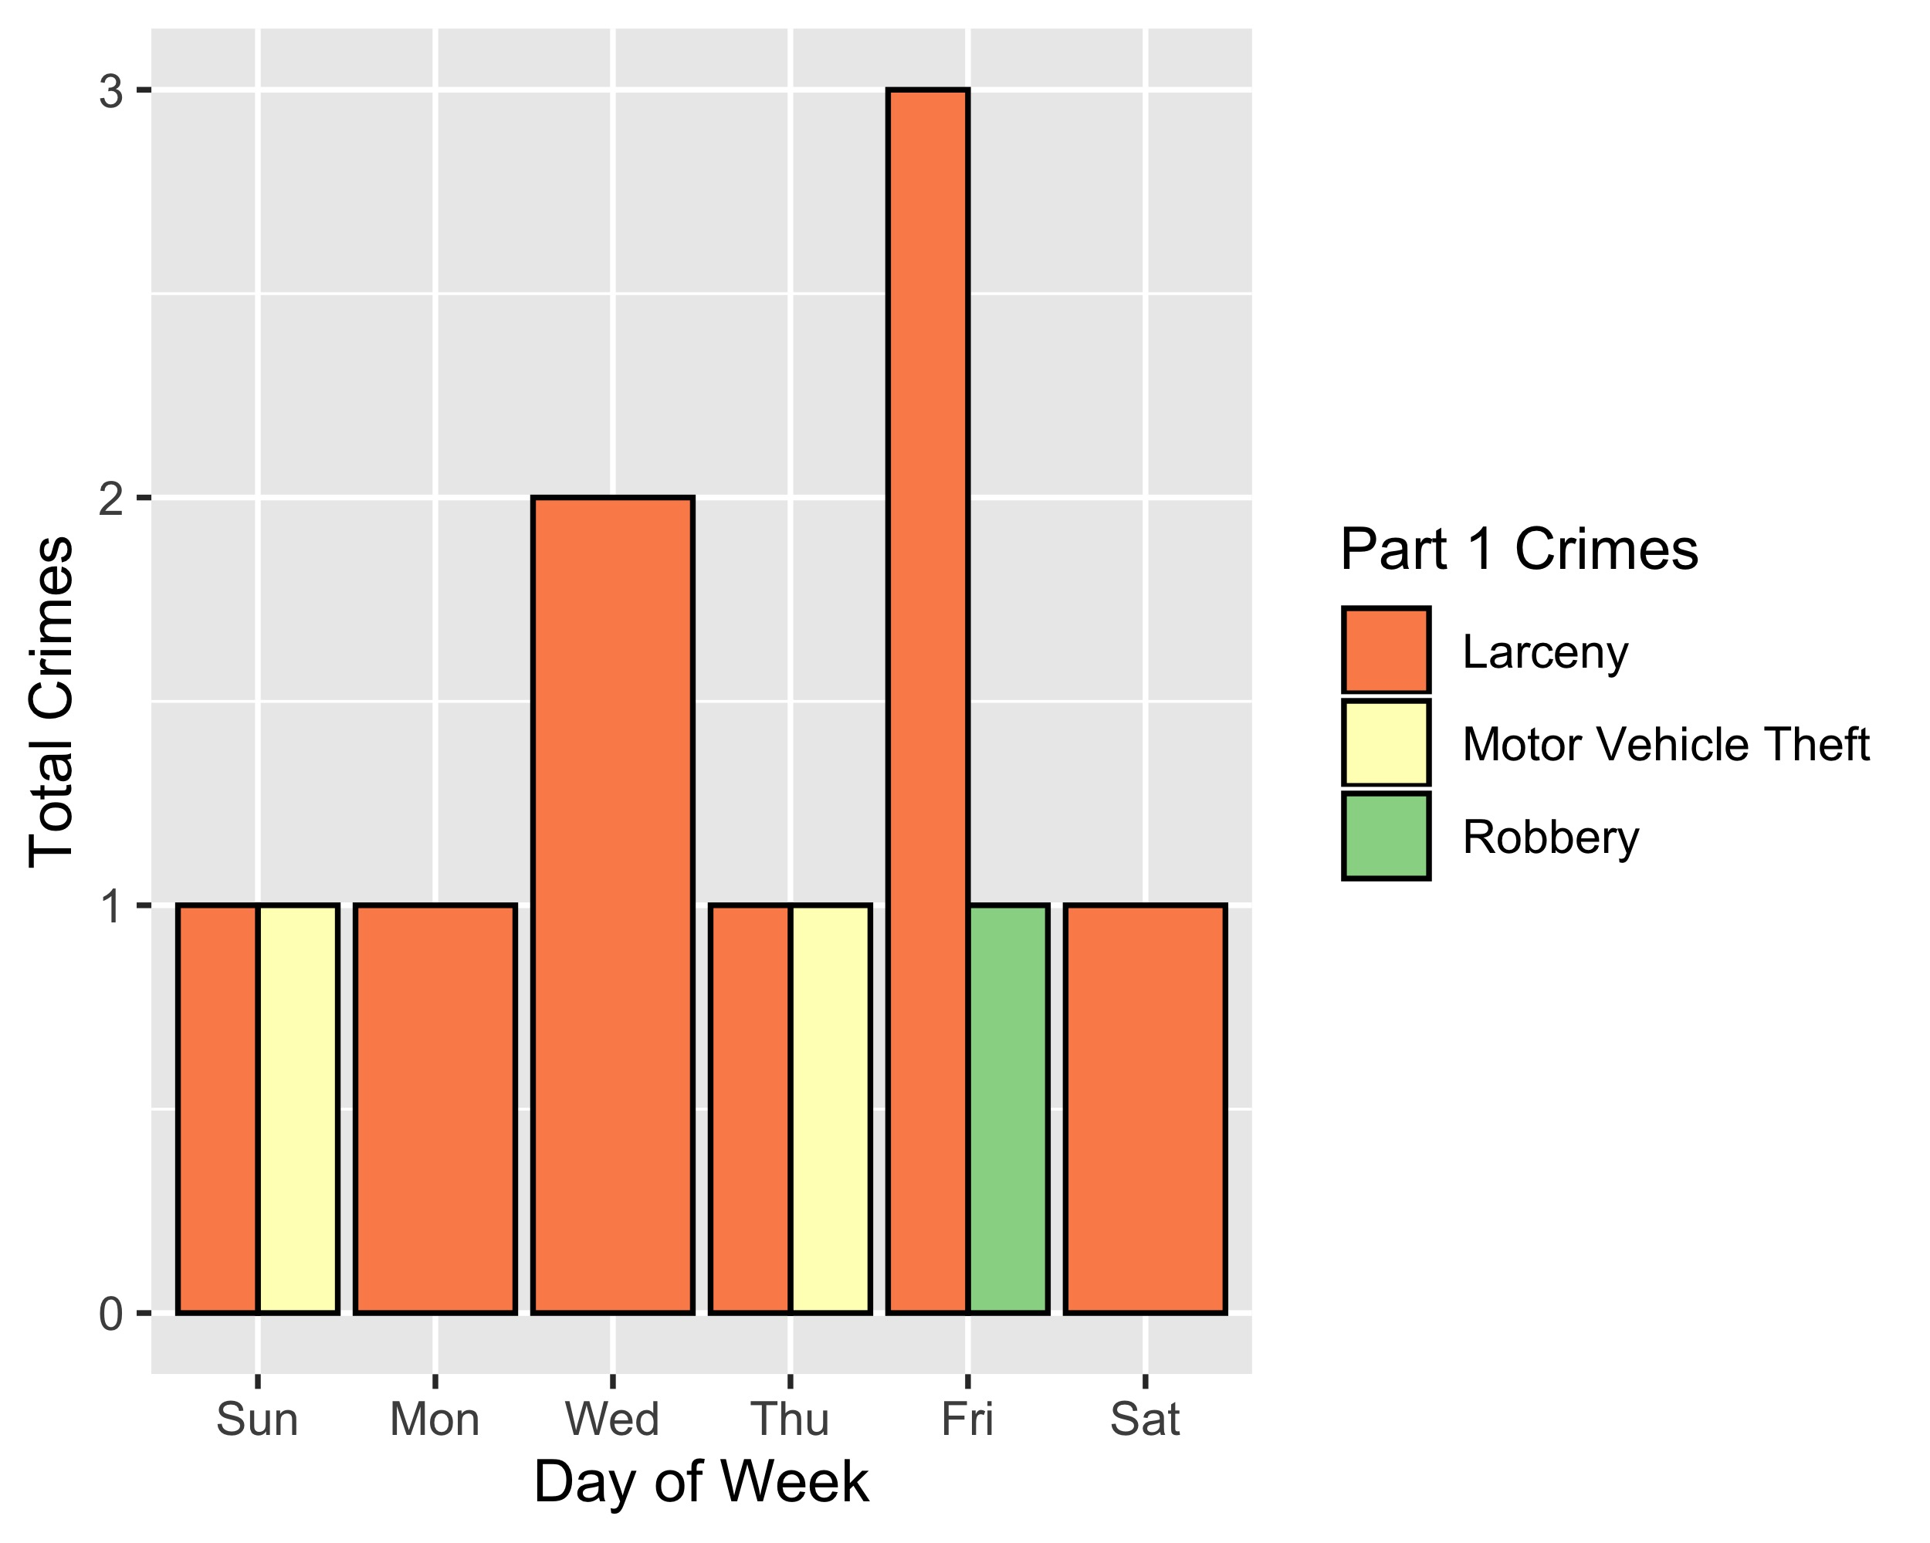
Academy: Crimes by Day & Category

Slide 28
Fountain Park: Neighborhood Detail
Appendix 2

Slide 29
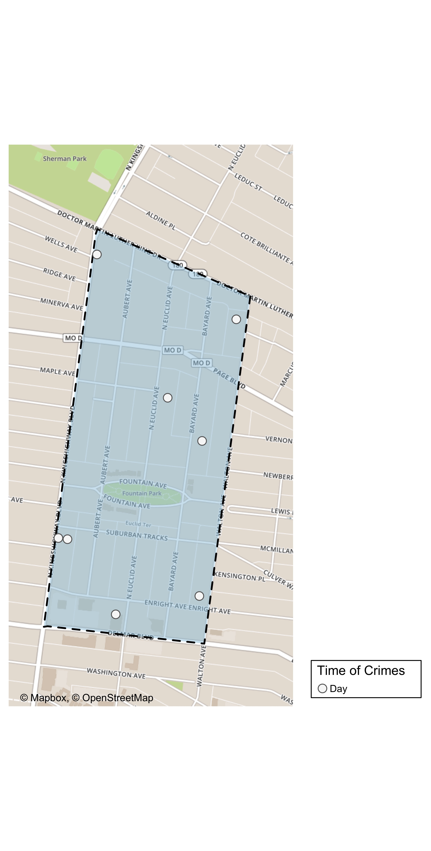
Fountain Park: Time of Crimes Map

Slide 30
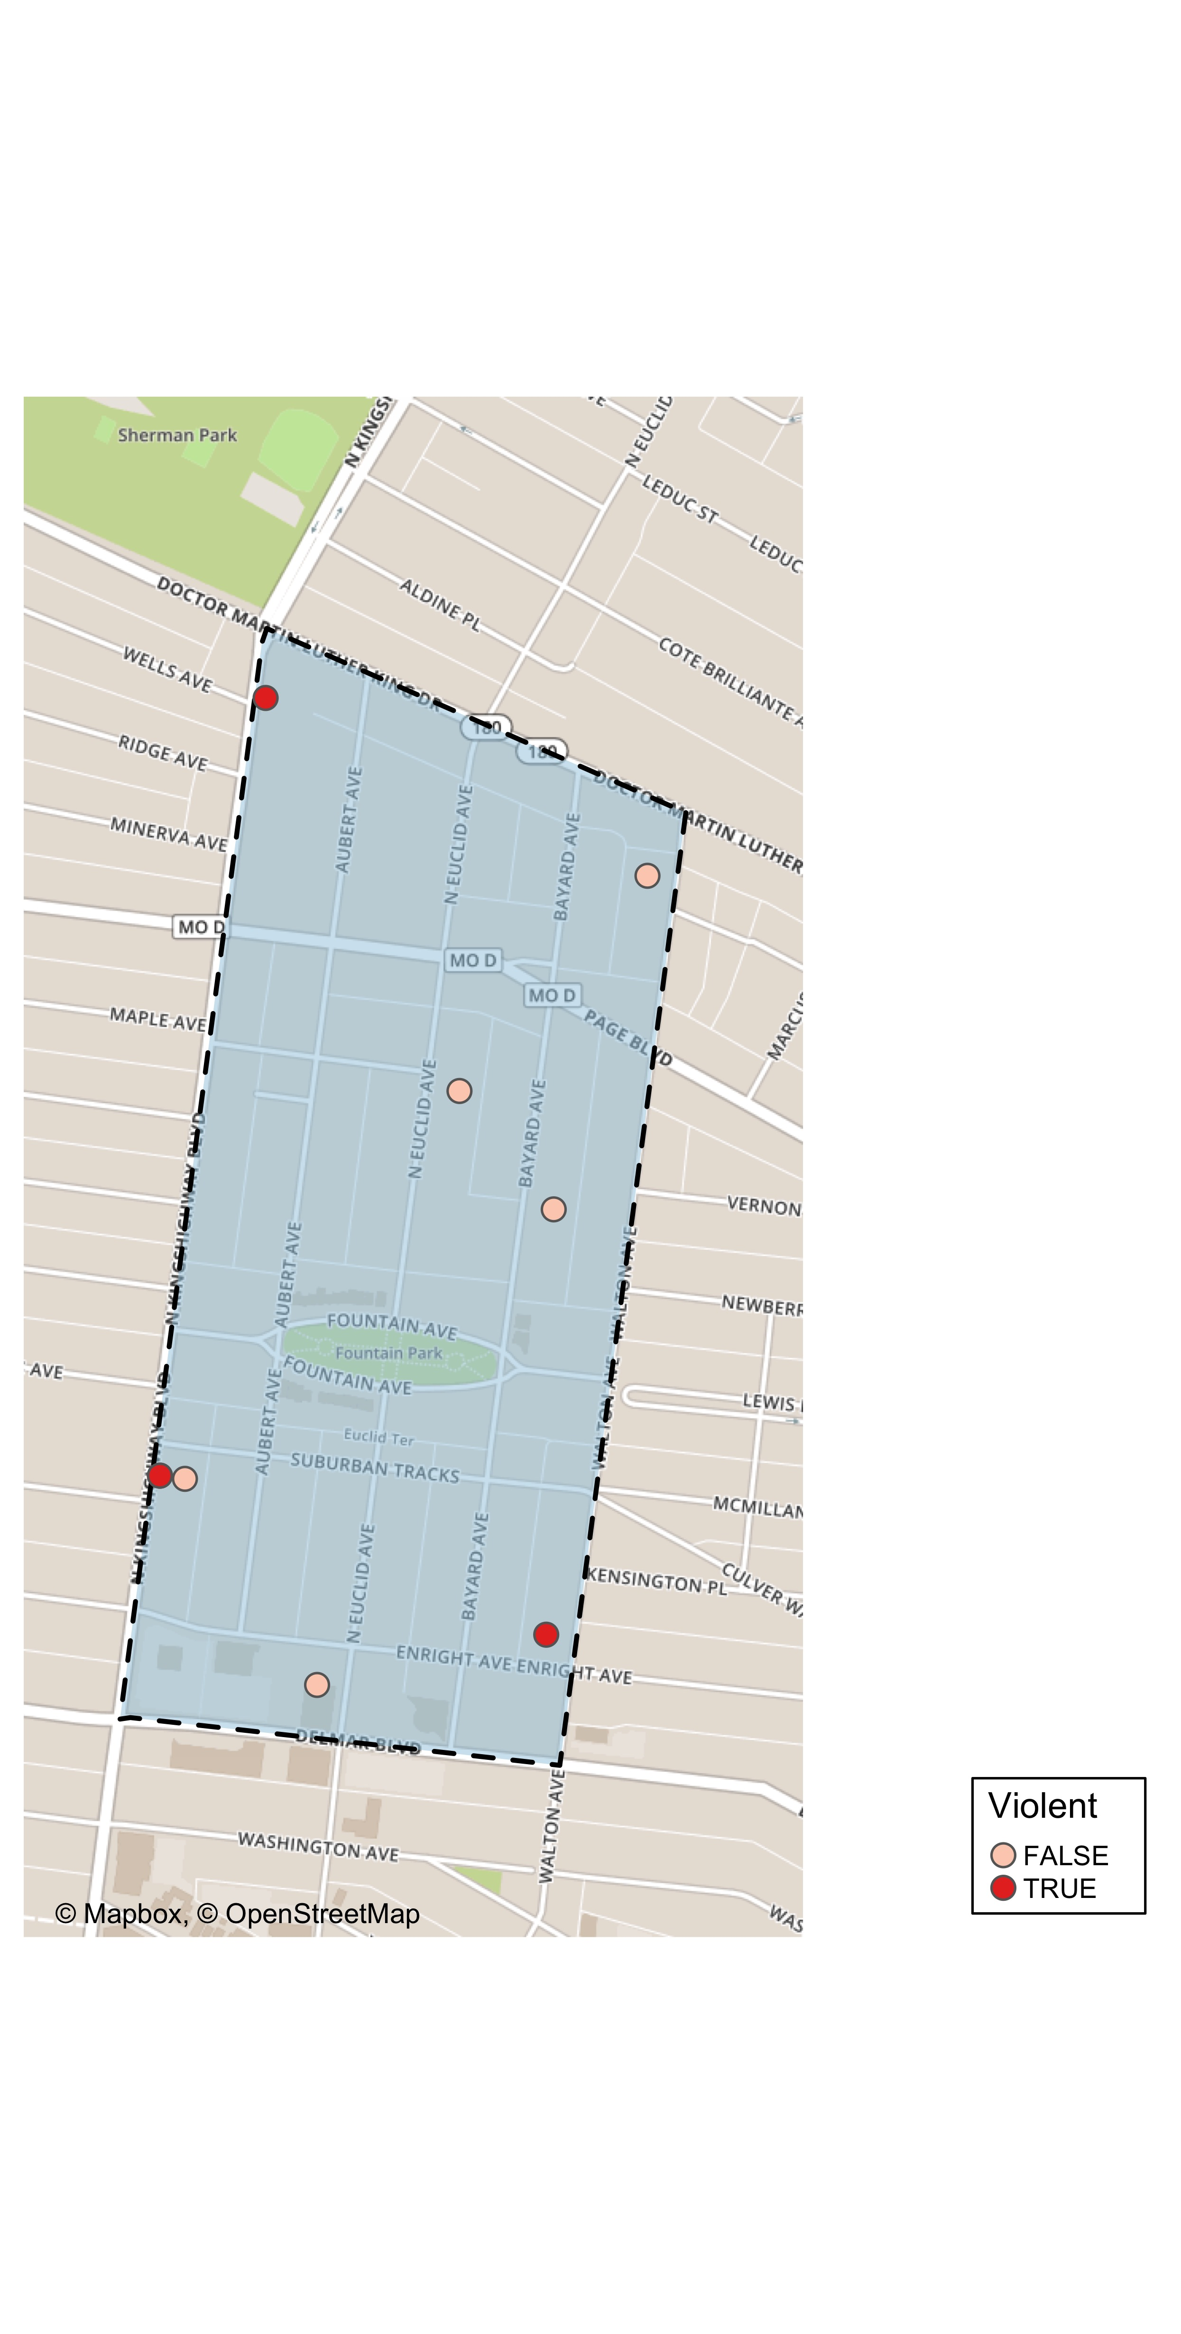
Fountain Park: Violent Crime Map

Slide 31
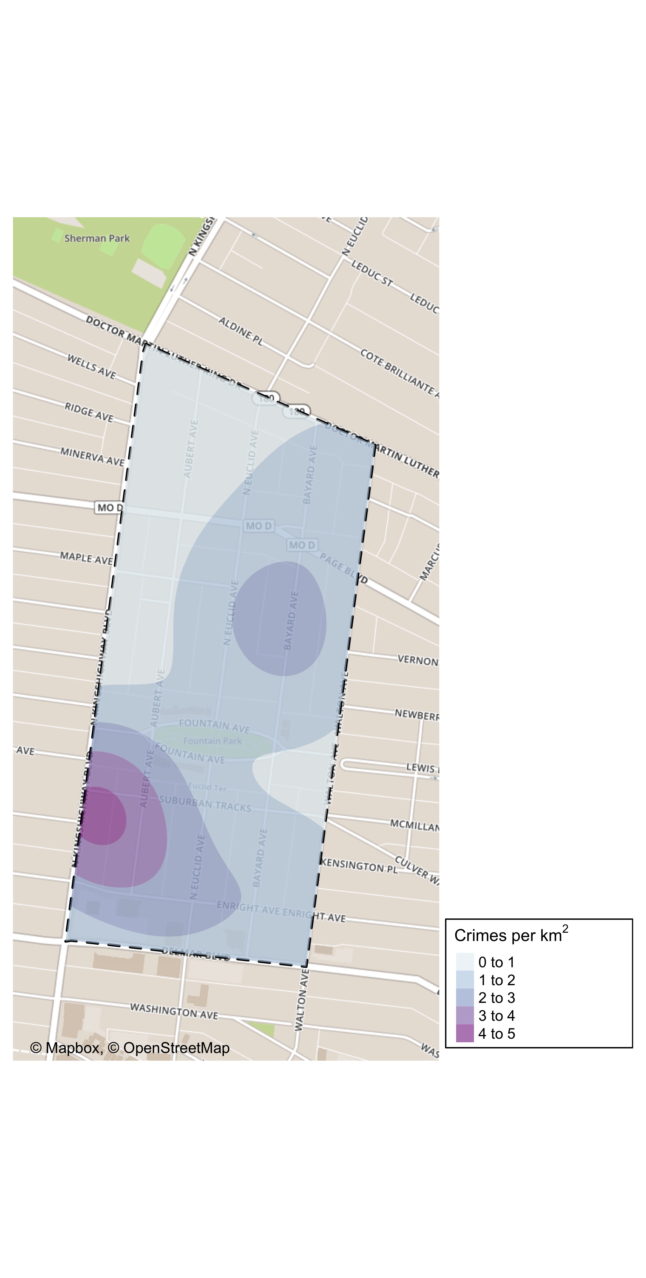
Fountain Park: Crime Density Map

Slide 32
Fountain Park: Larceny Breakdown
Day of the Week | Number of Crimes
Sun | 1
Tue | 2
Total | 3
Time of Day | Number of Crimes
Day | 3
Total | 3
Type of Larceny | Number of Crimes
All Other | 2
From Motor Vehicle | 1
Total | 3
Monetary | Number of Crimes
$500 - $24,999 | 3
Total | 3

Slide 33
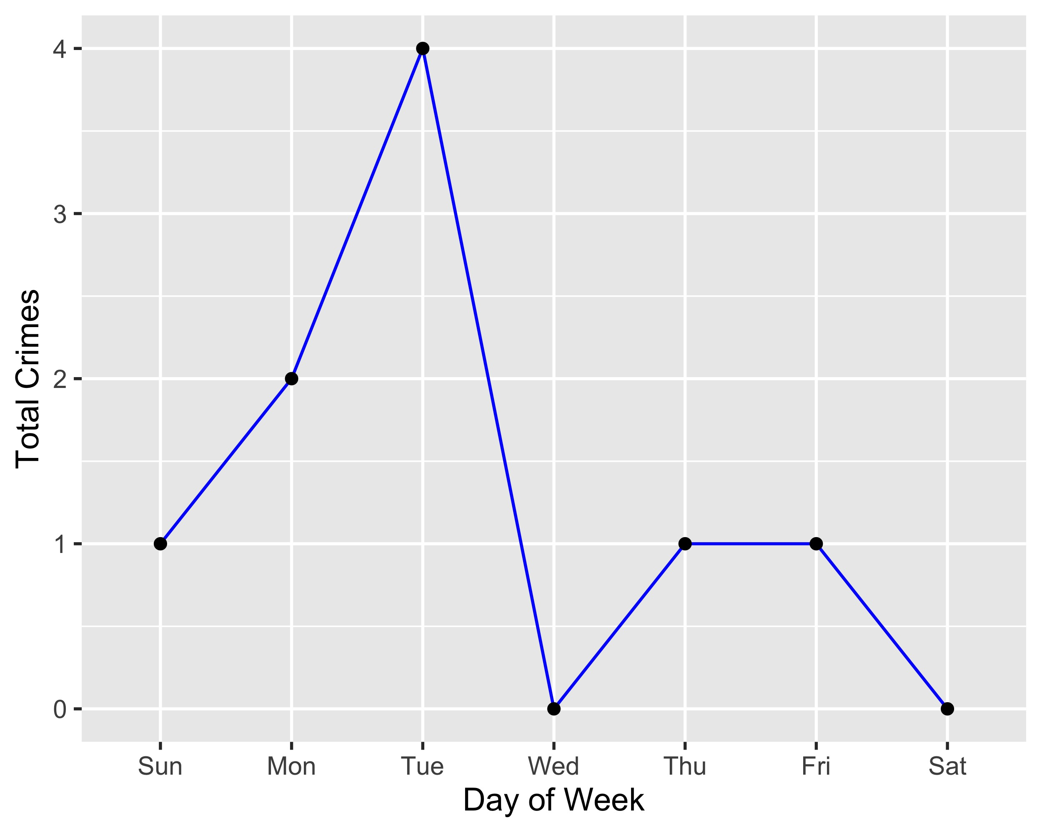
Fountain Park: Total Crimes by Days of the Week

Slide 34
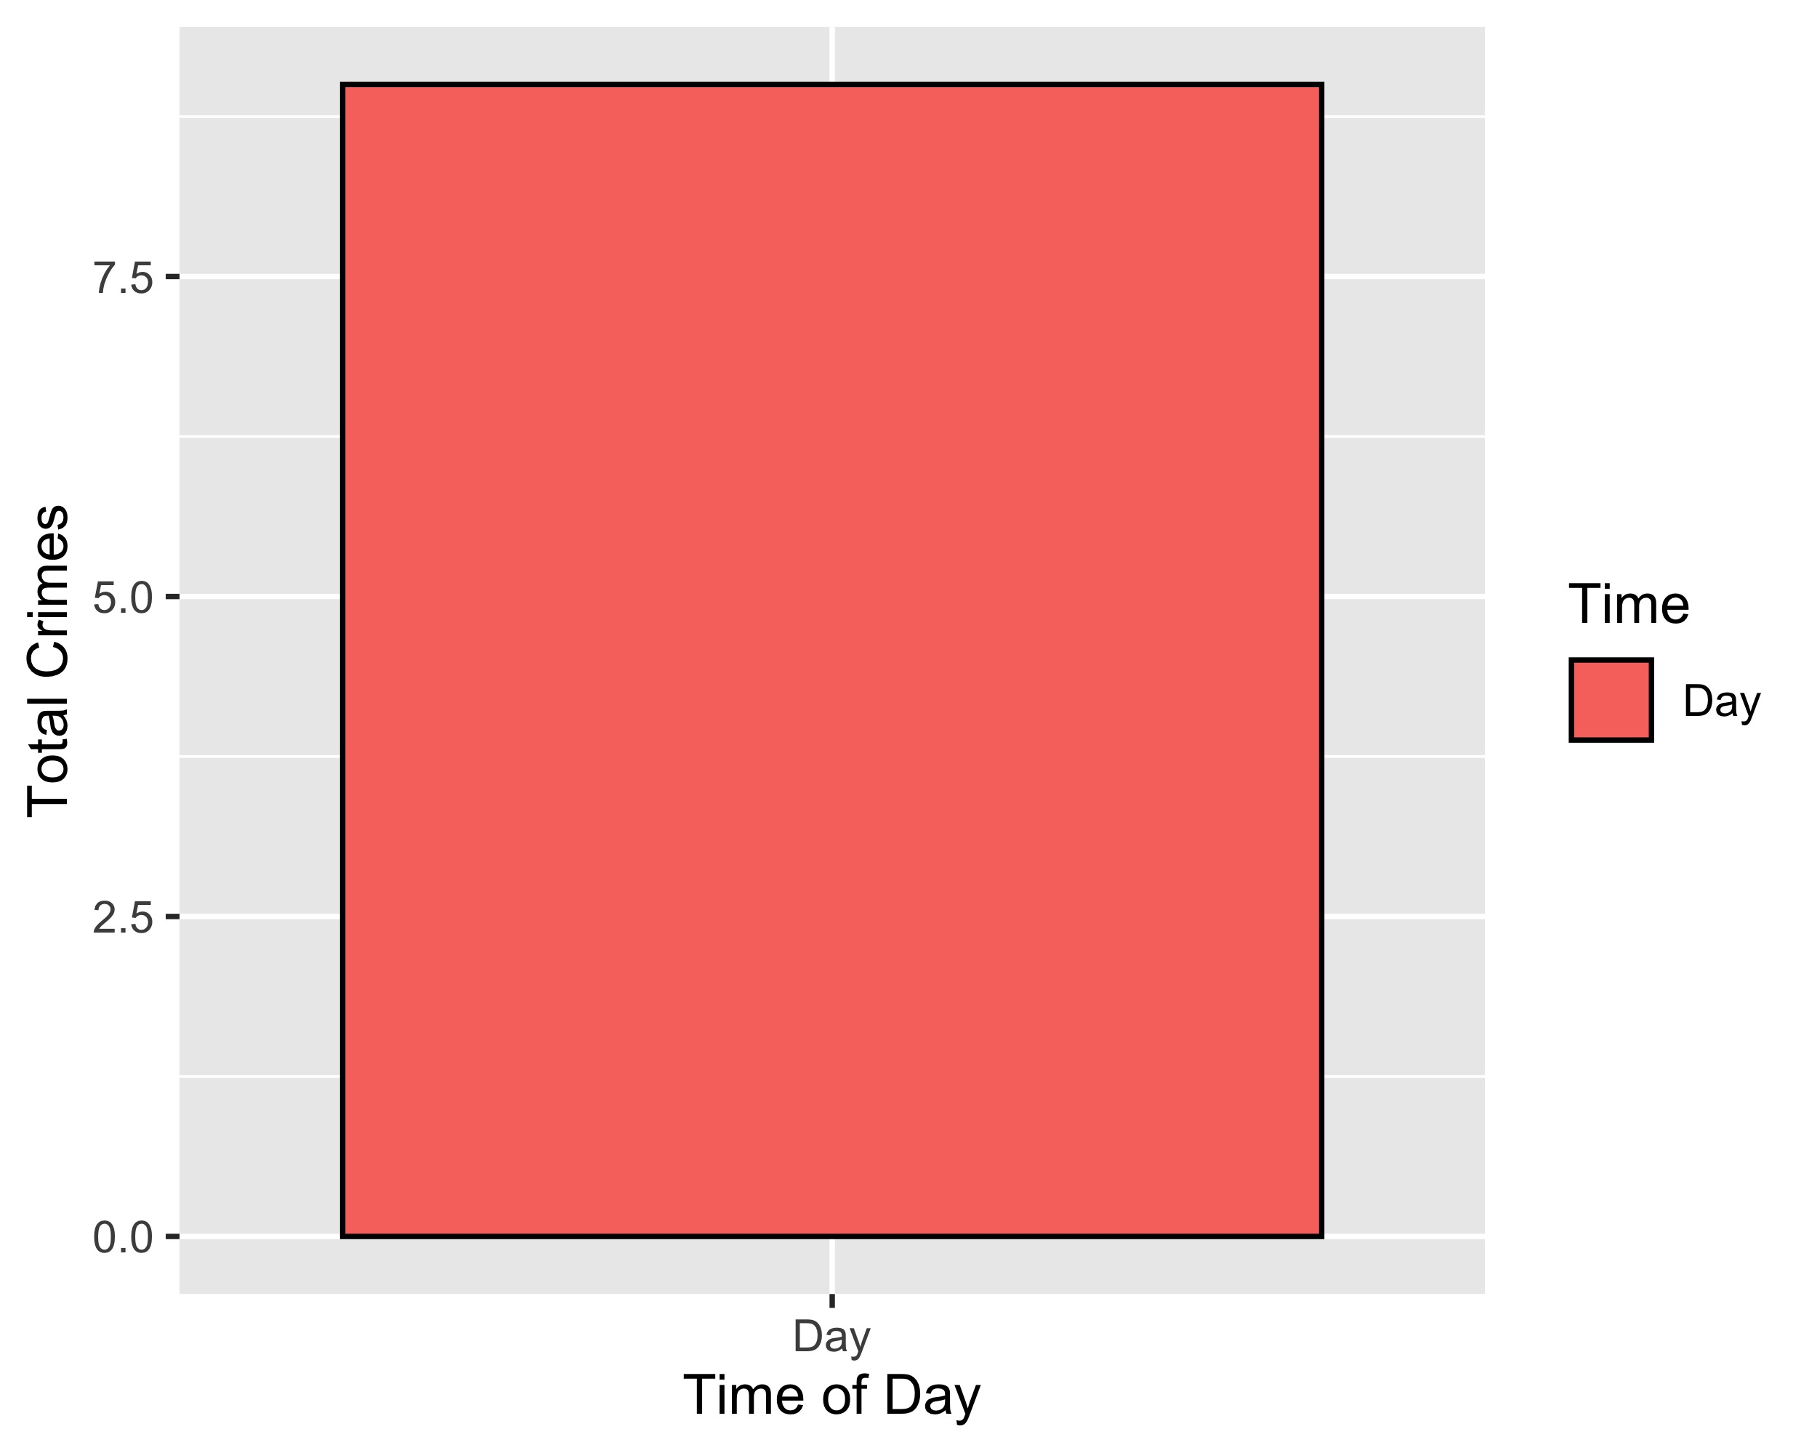
Fountain Park: Crimes by Time of Day

Slide 35
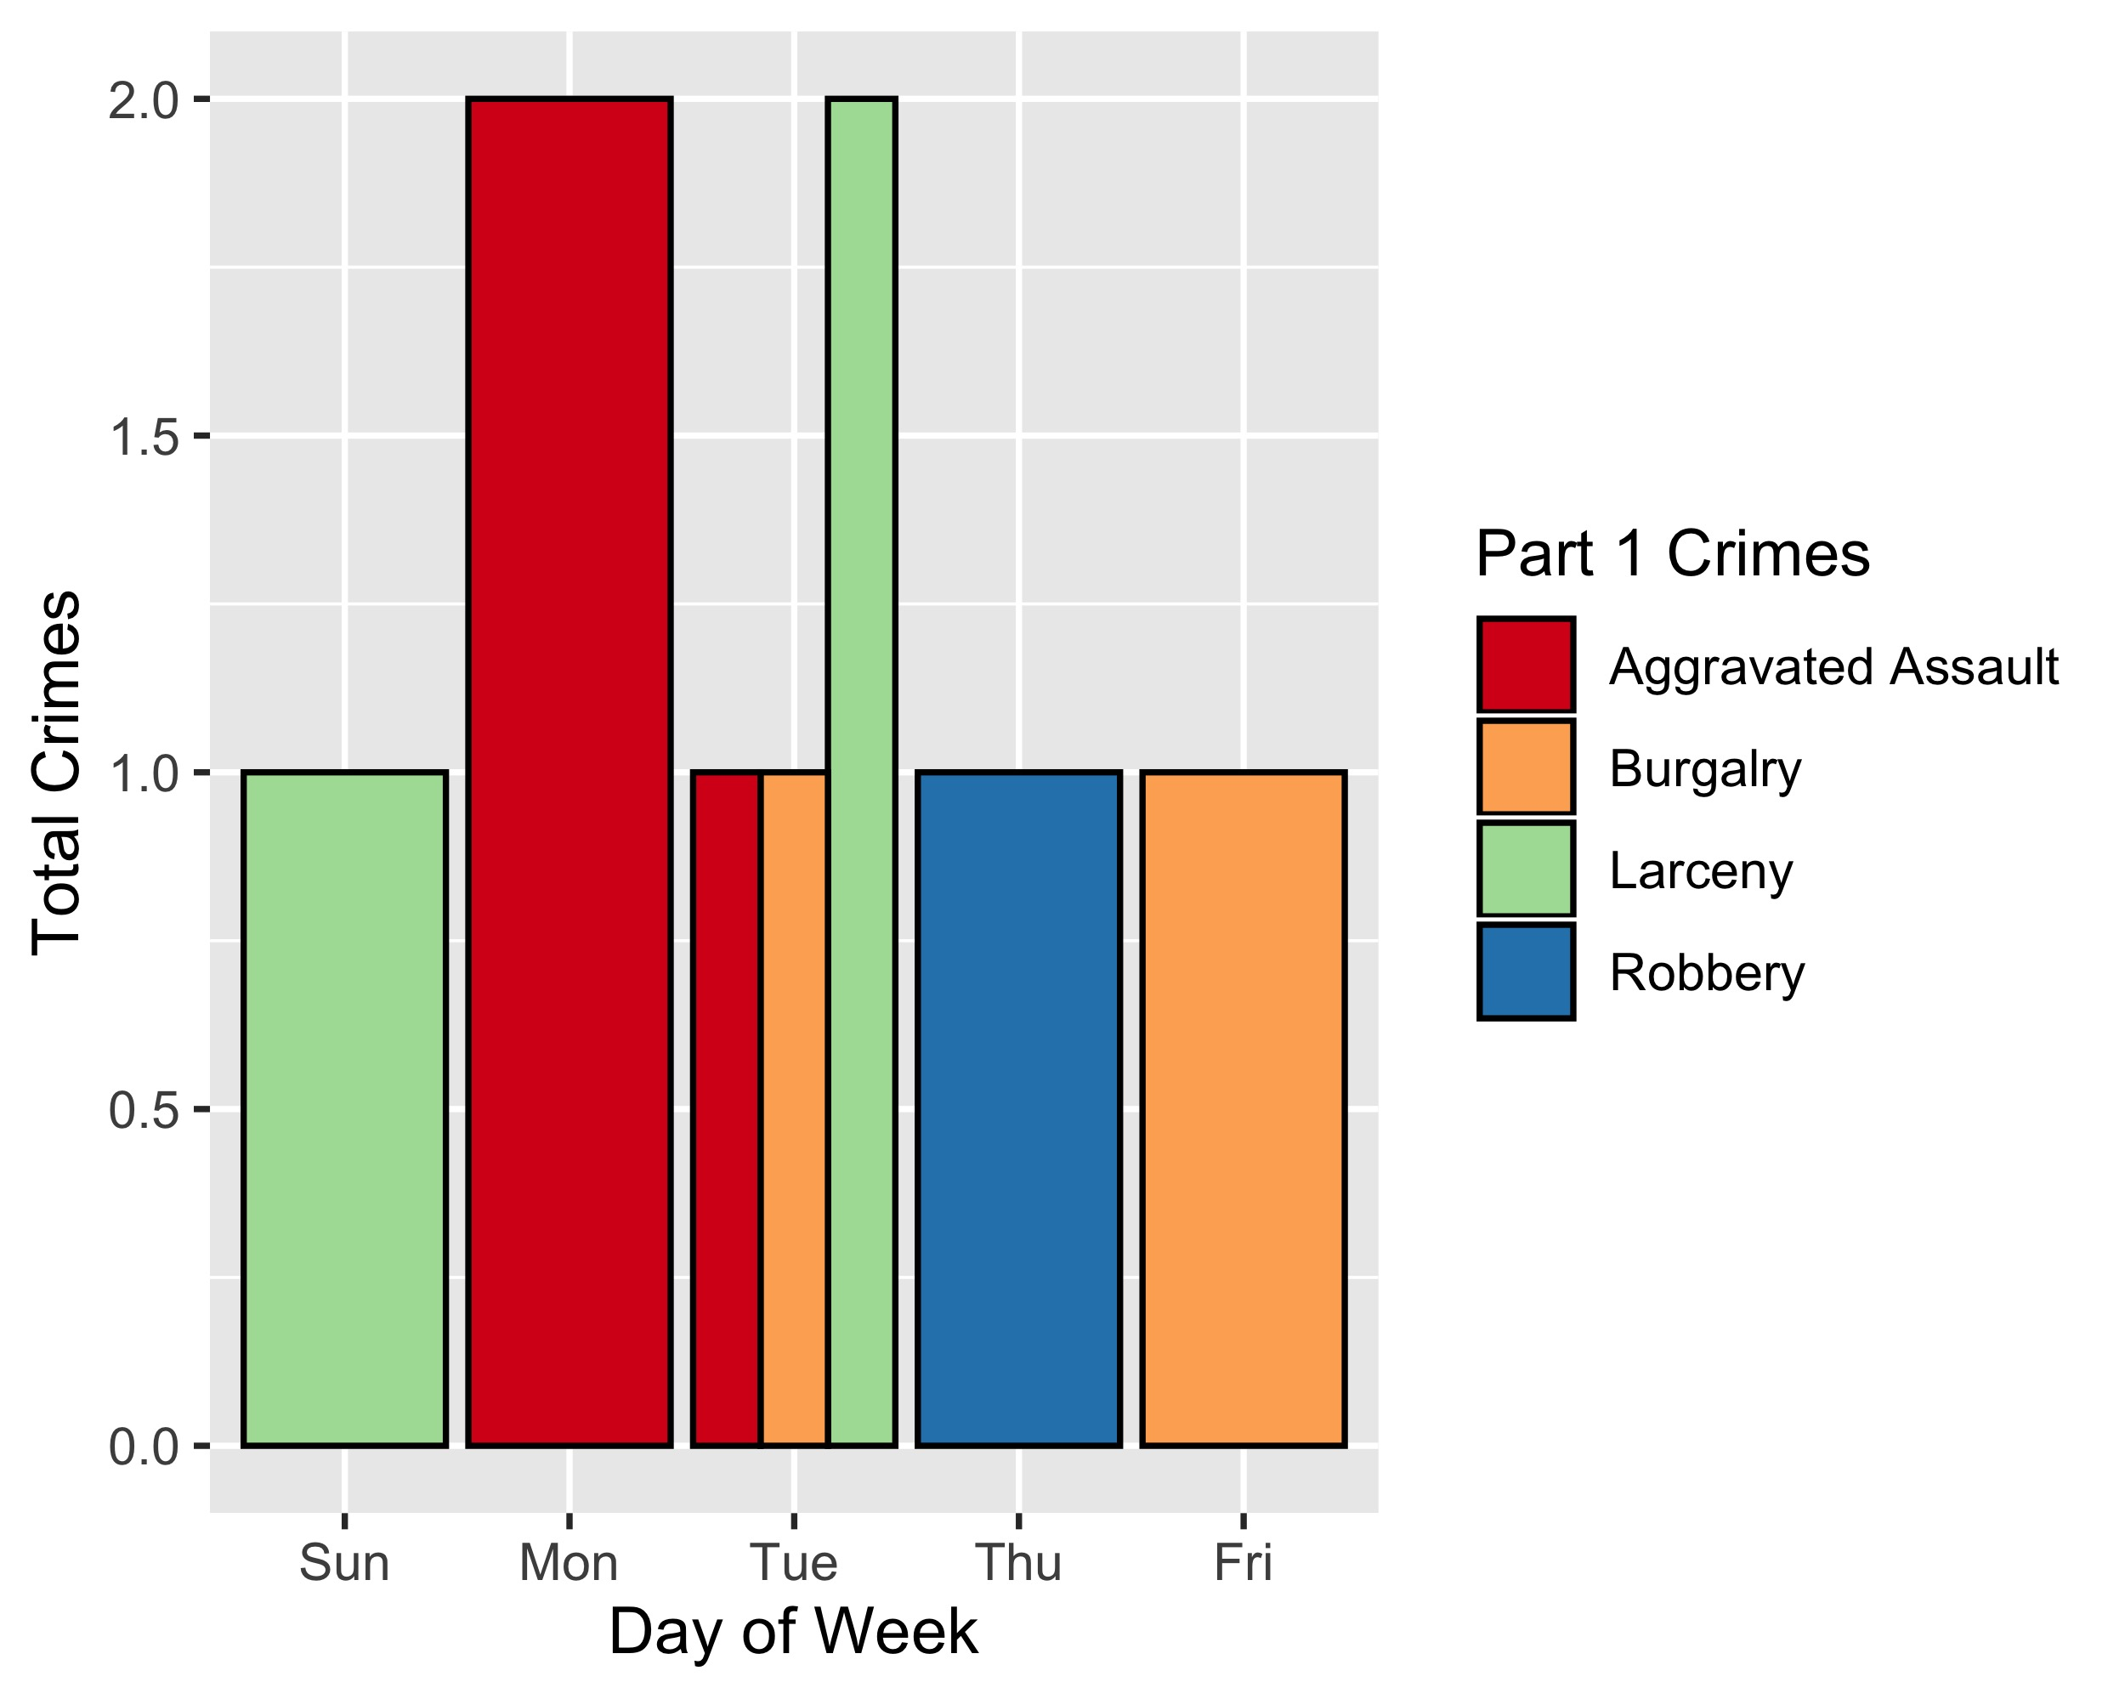
Fountain Park: Crimes by Day & Category

Slide 36
Lewis Place: Neighborhood Detail
Appendix 3

Slide 37
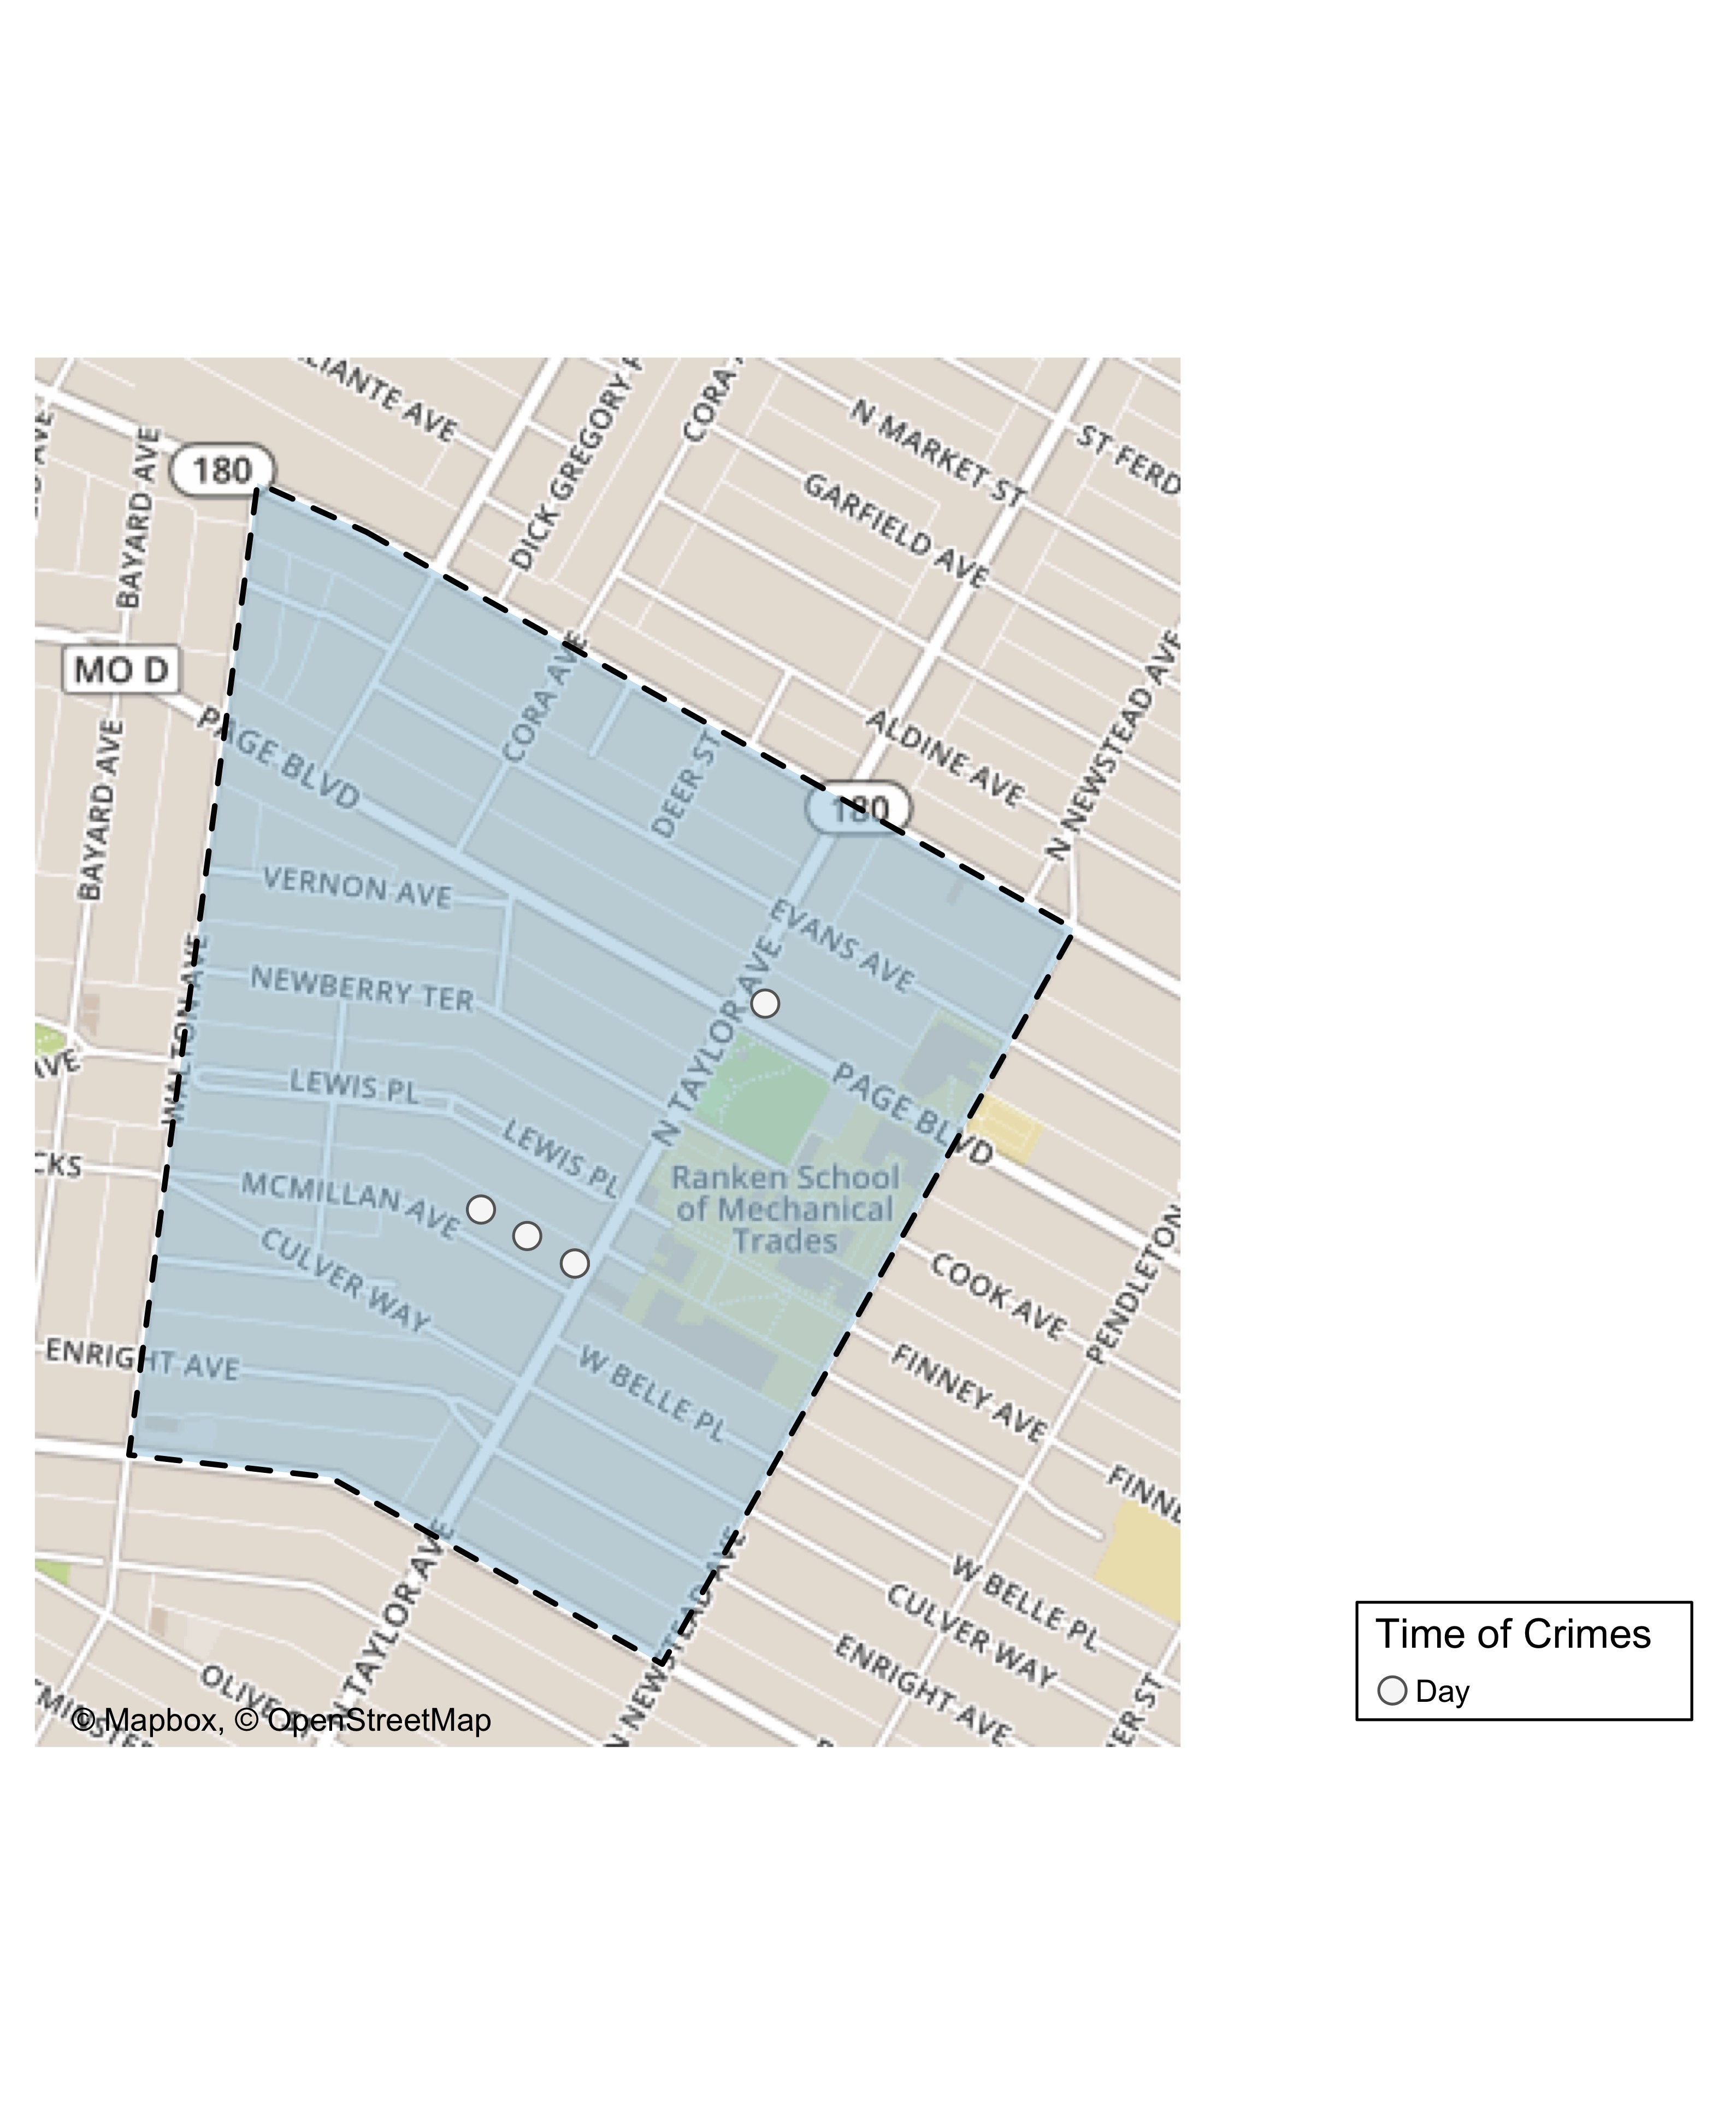
Lewis Place: Time of Crimes Map

Slide 38
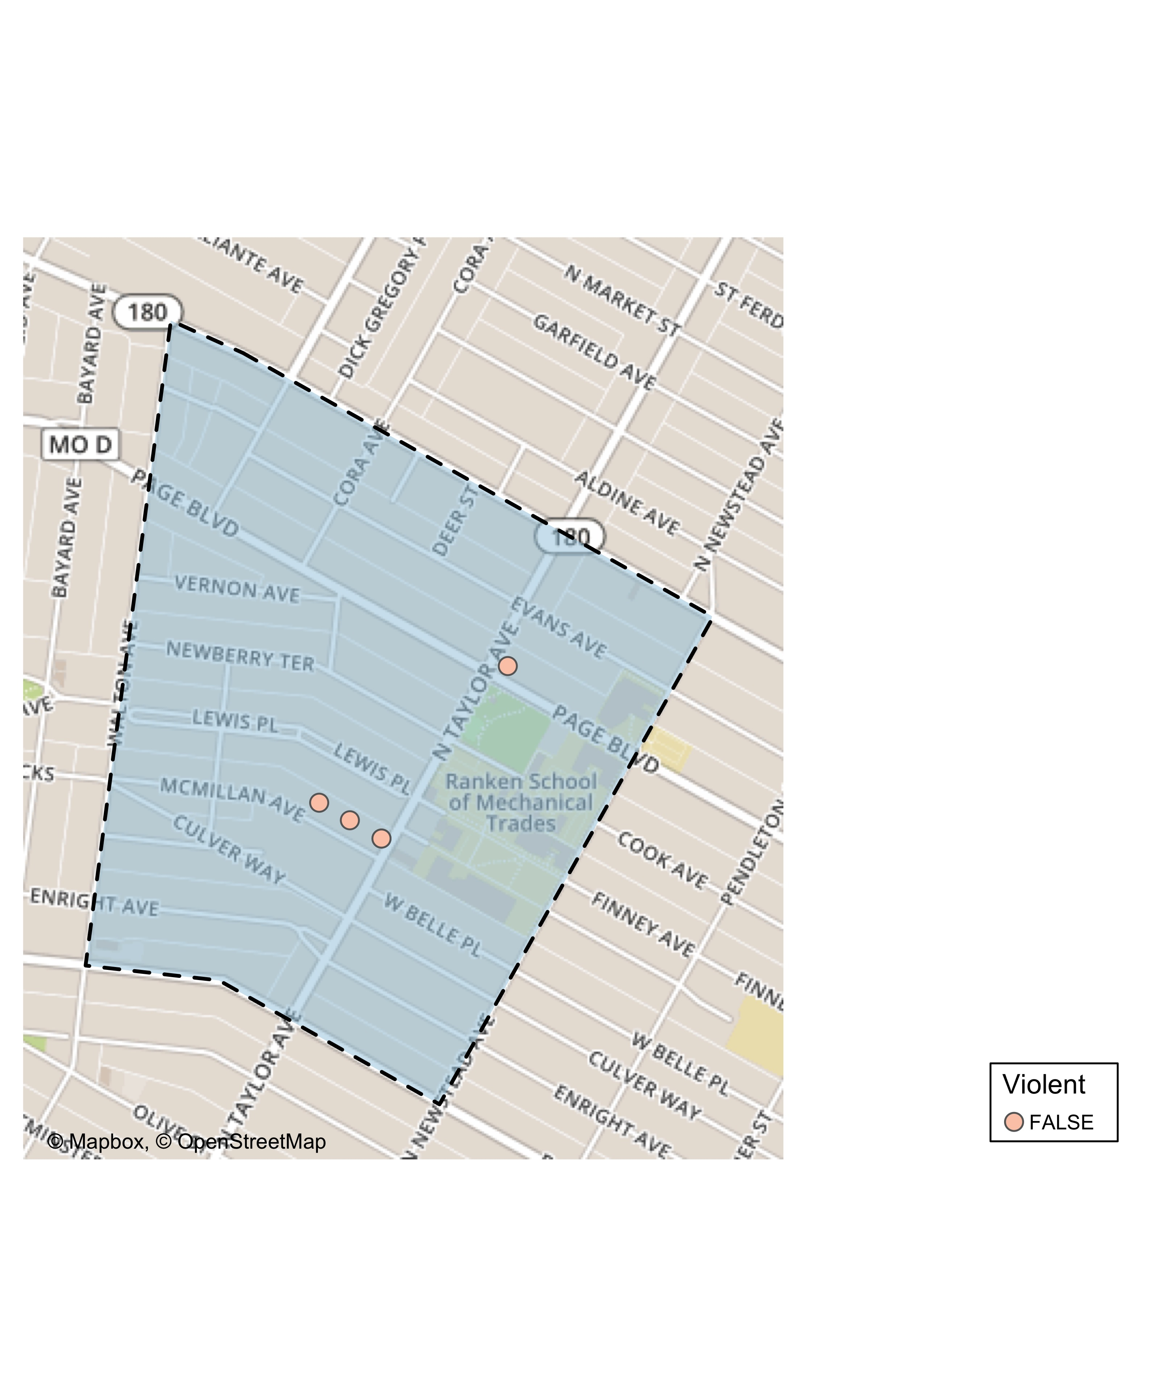
Lewis Place: Violent Crime Map

Slide 39
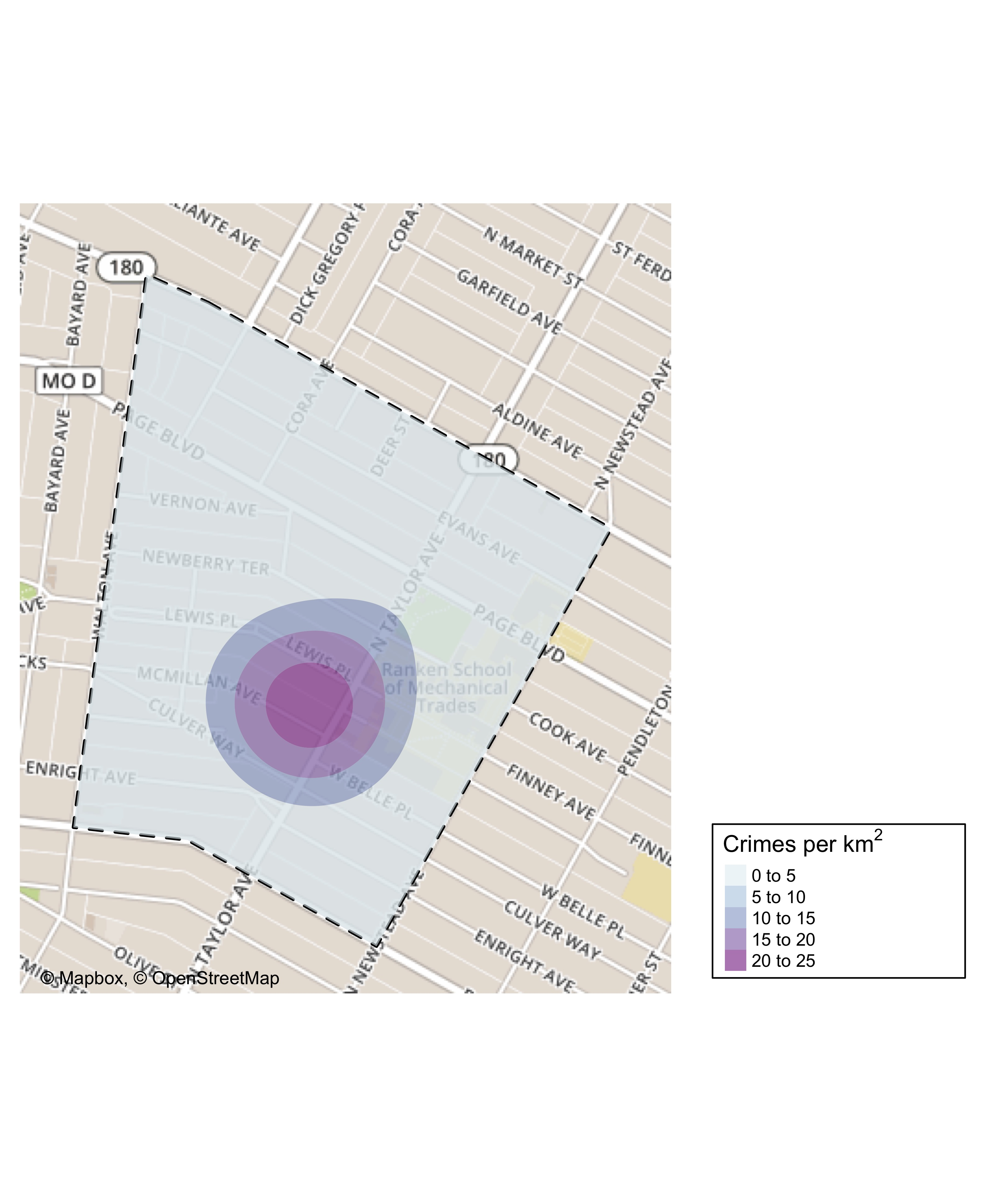
Lewis Place: Crime Density Map

Slide 40
Lewis Place: Larceny Breakdown
Day of the Week | Number of Crimes
 | 0
Total | 0
Time of Day | Number of Crimes
Total | 0
Type of Larceny | Number of Crimes
Total | 0
Monetary | Number of Crimes
Total | 0

Slide 41
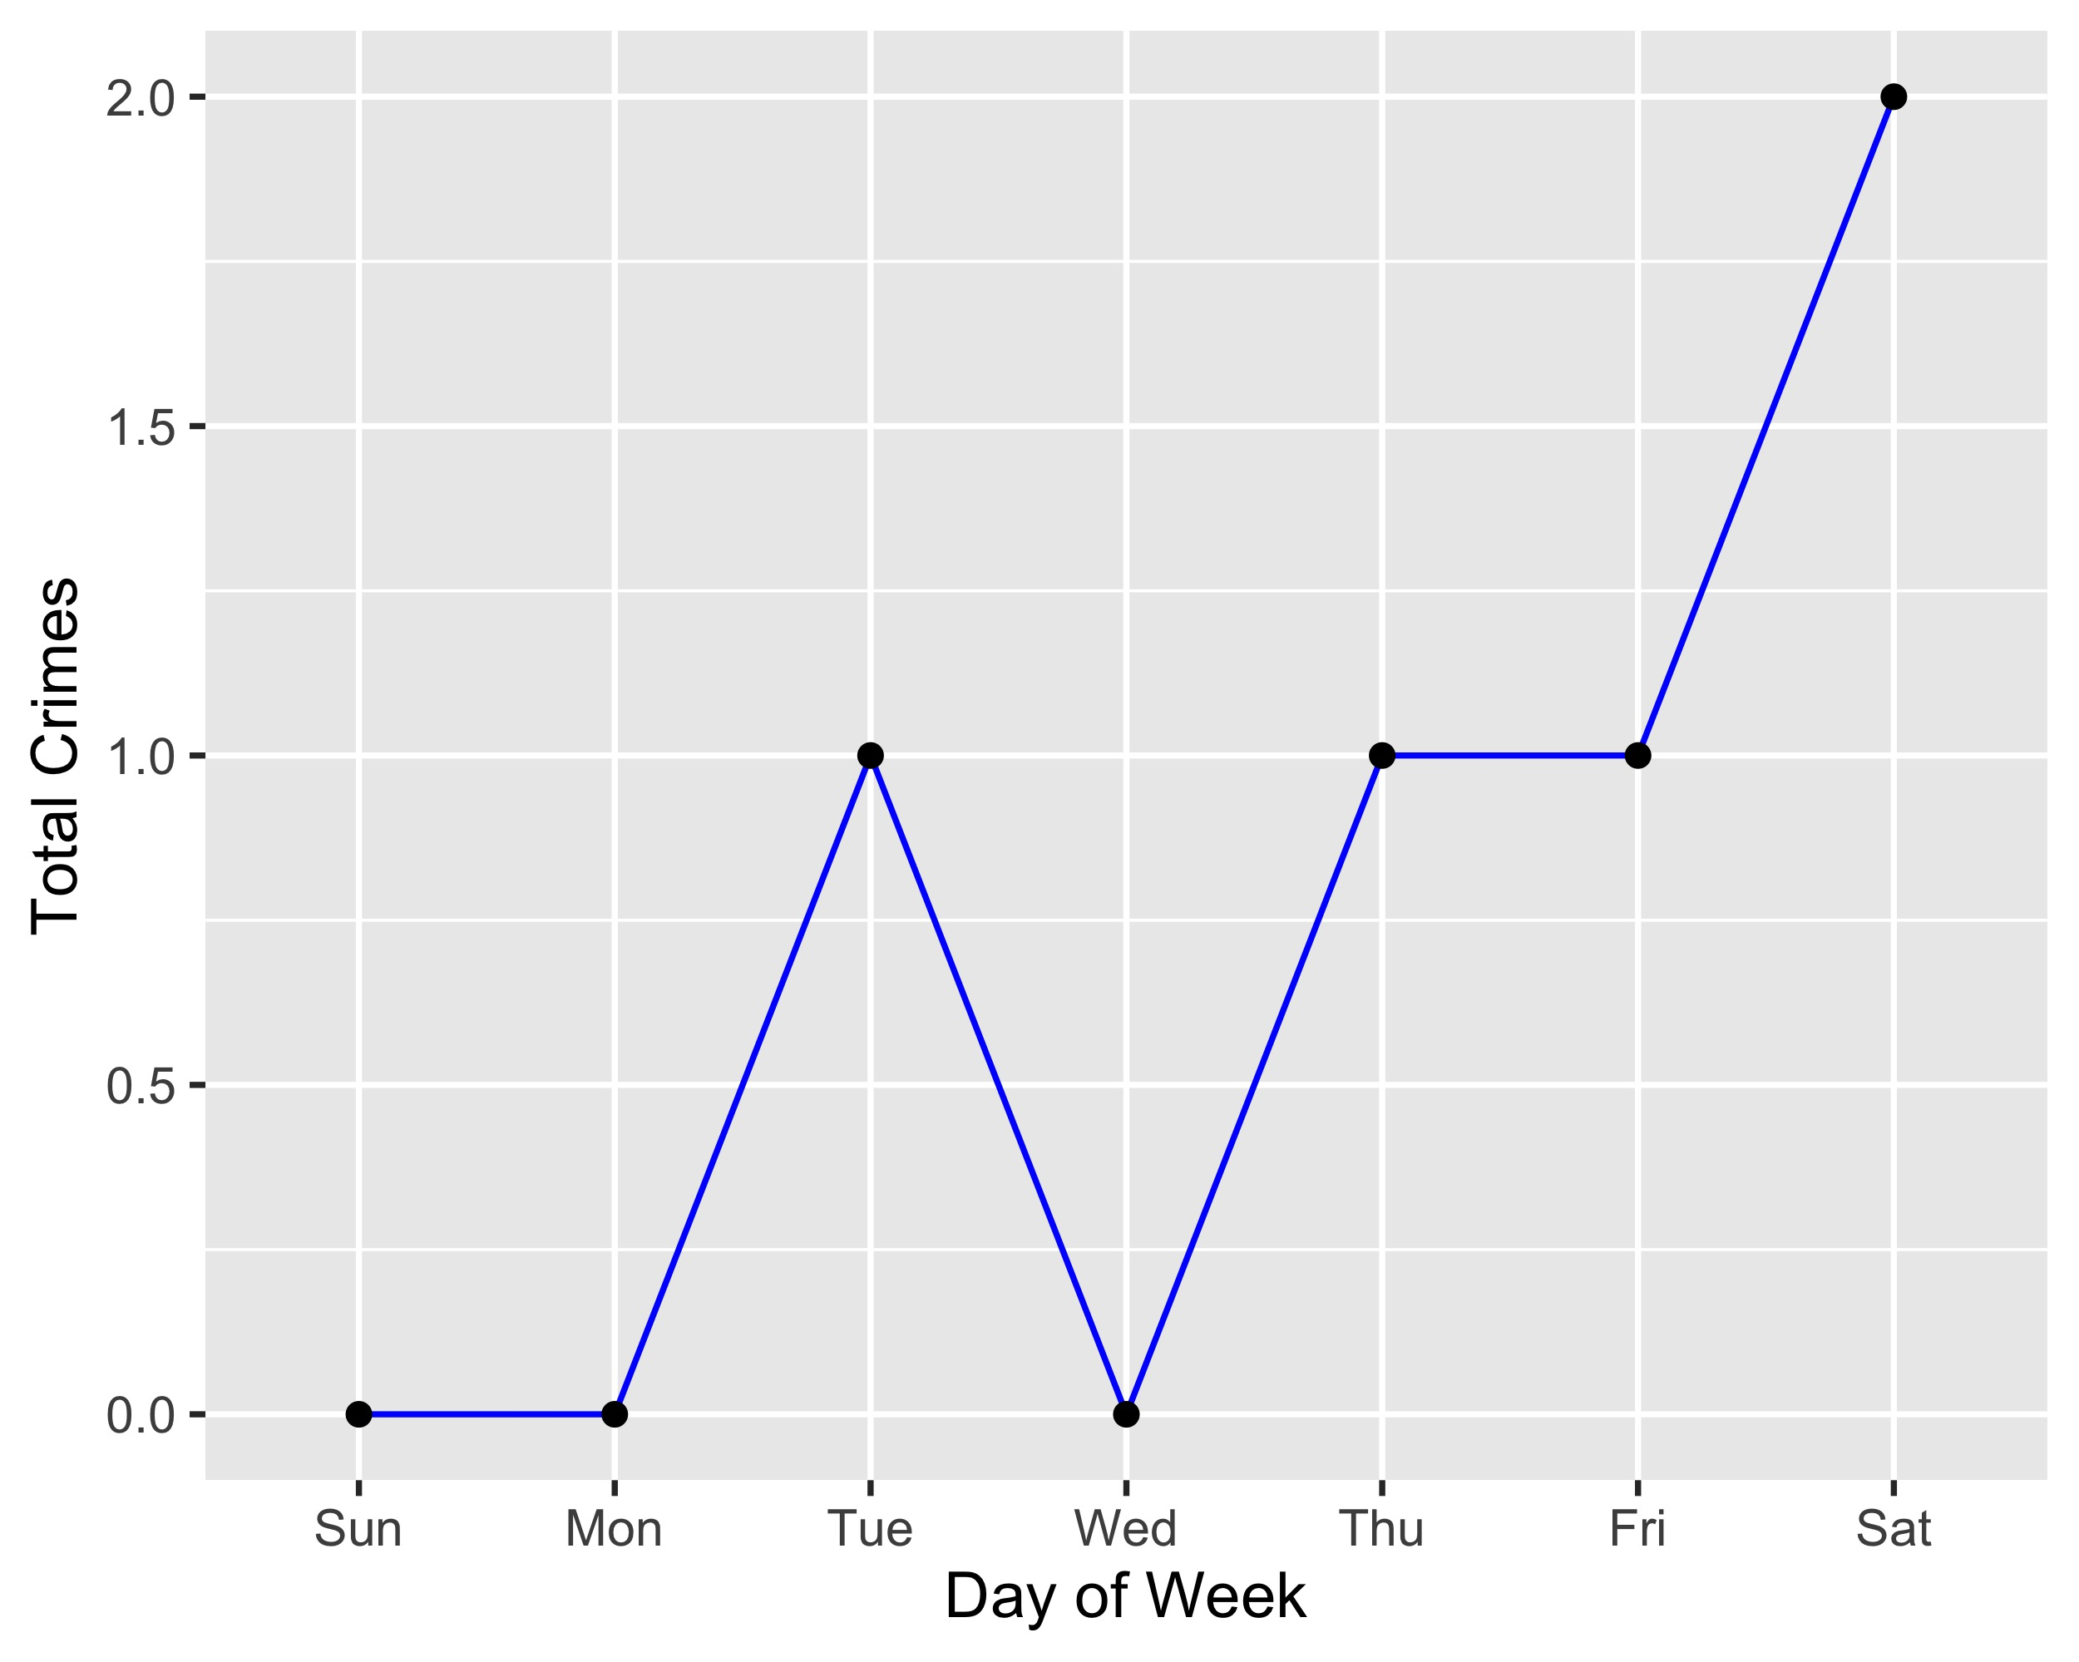
Lewis Place: Total Crimes by Days of the Week

Slide 42
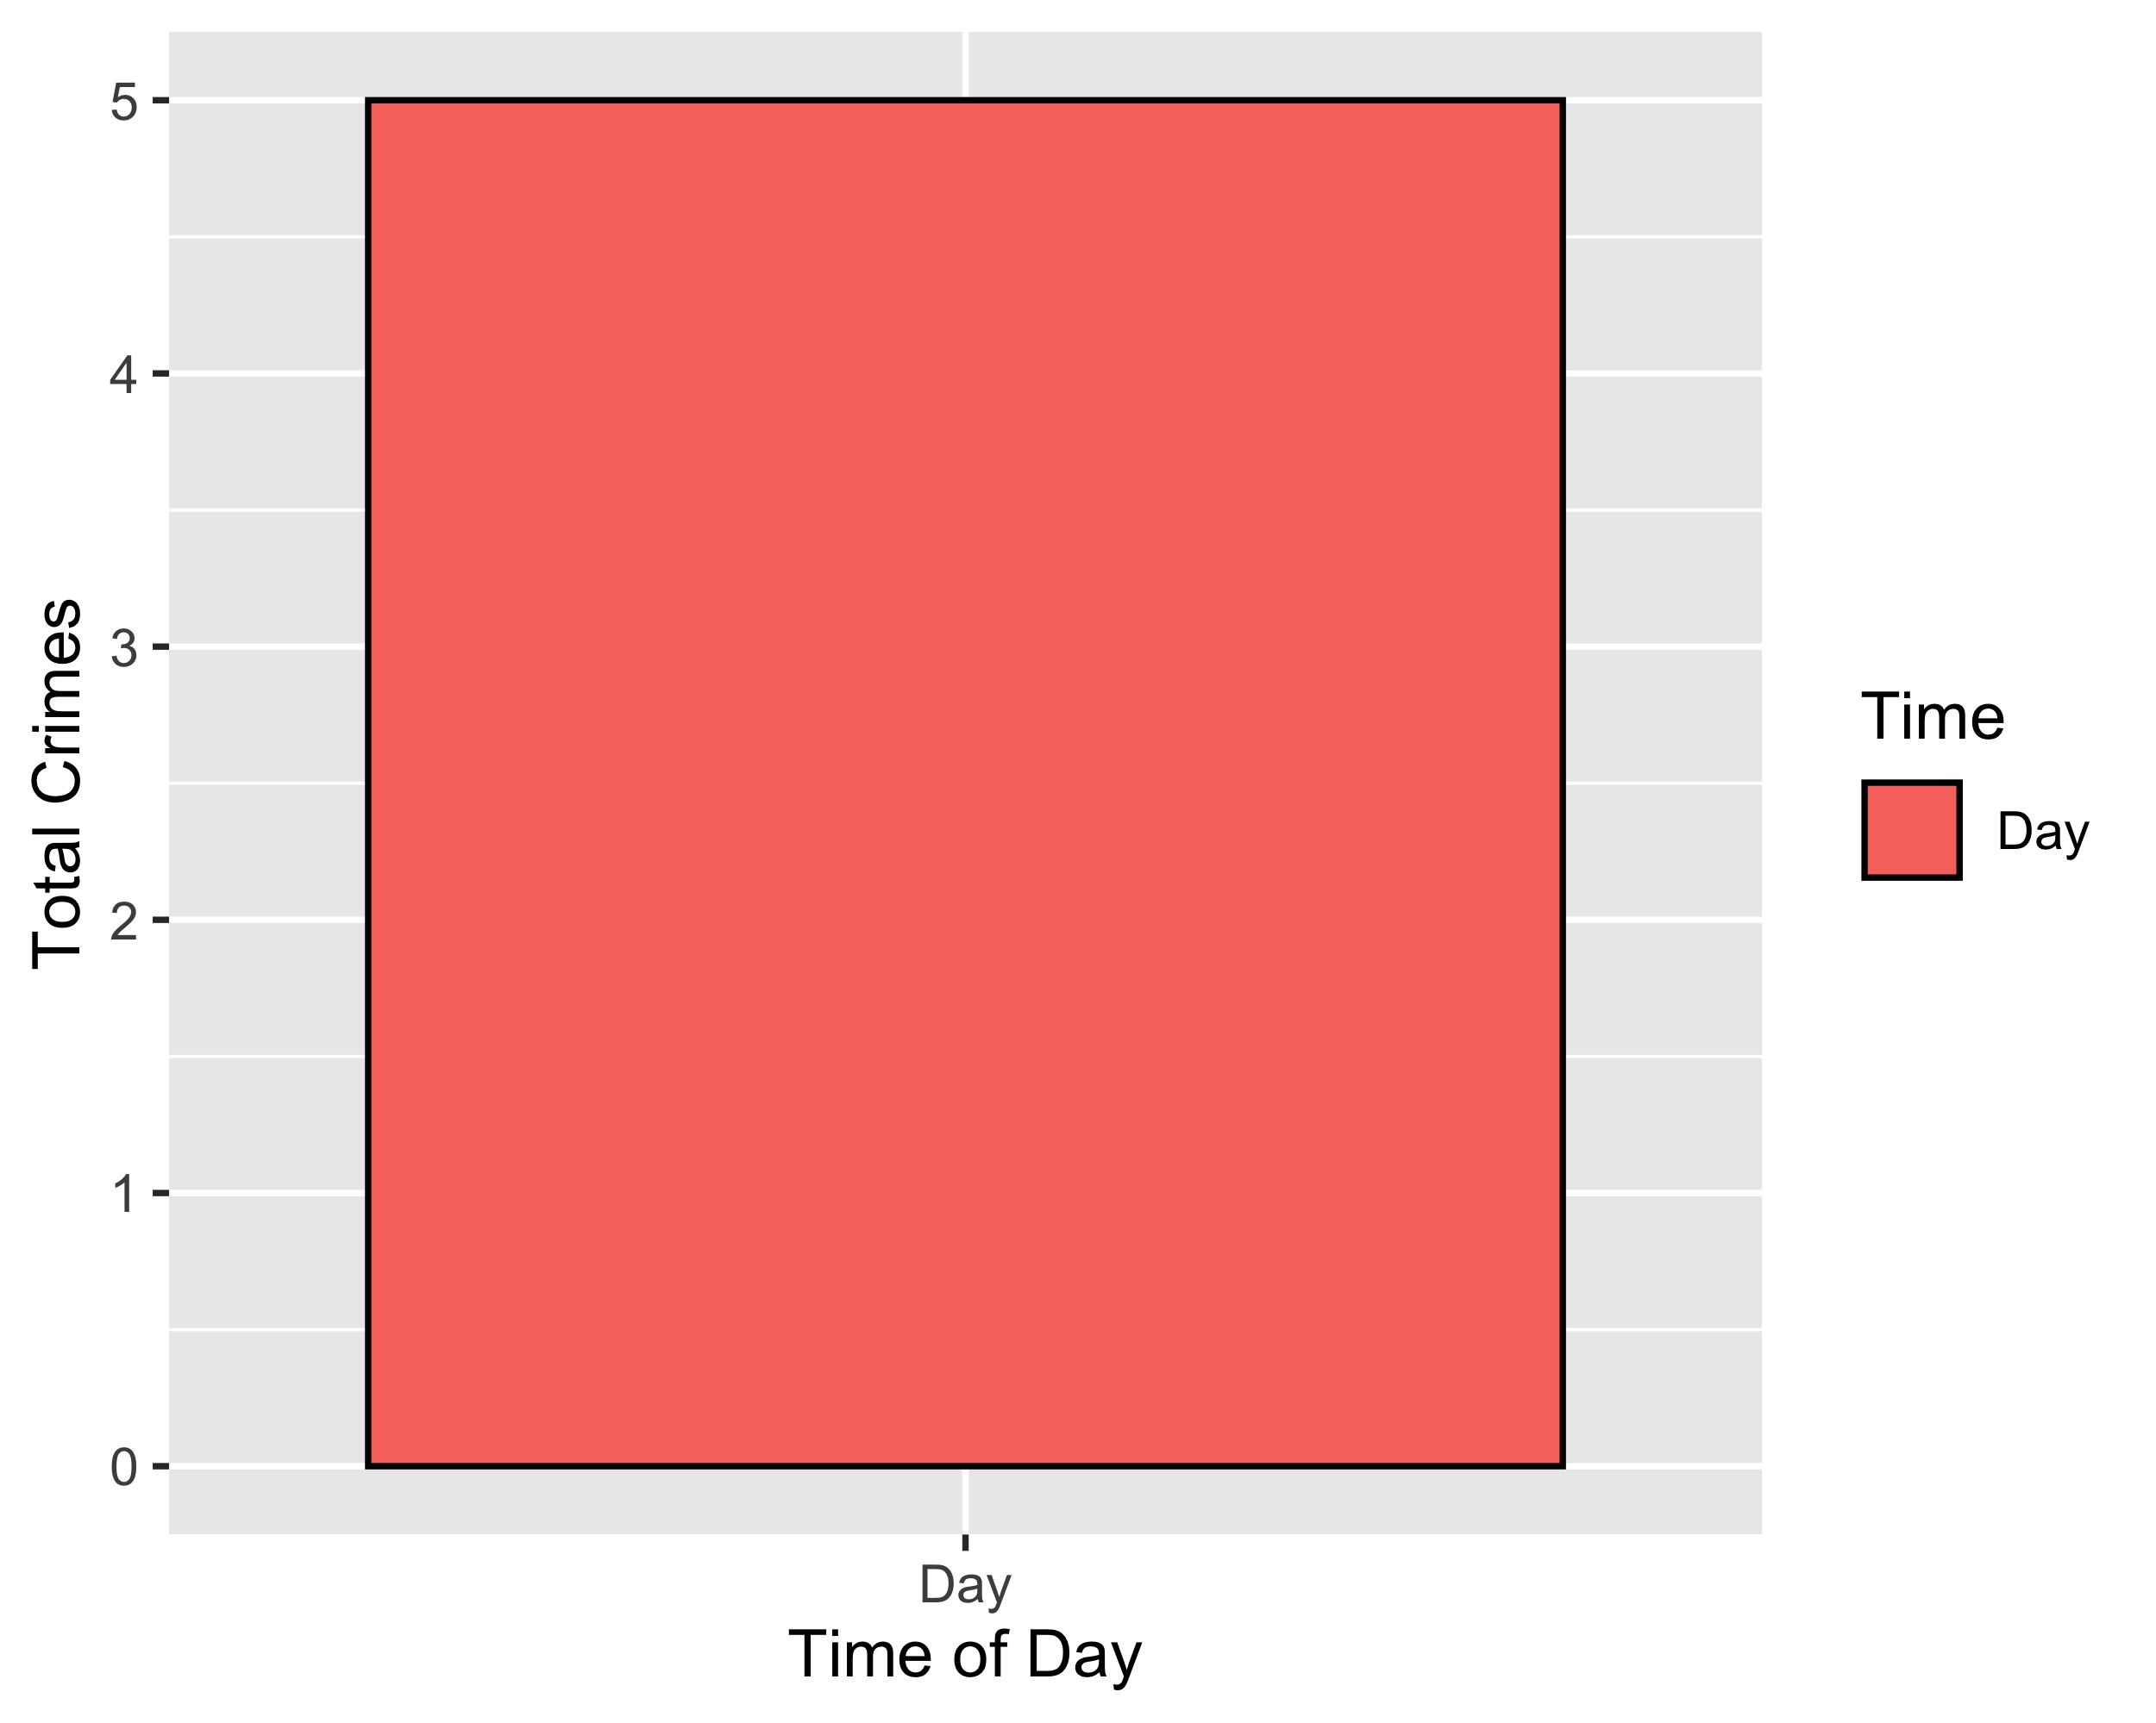
Lewis Place: Crimes by Time of Day

Slide 43
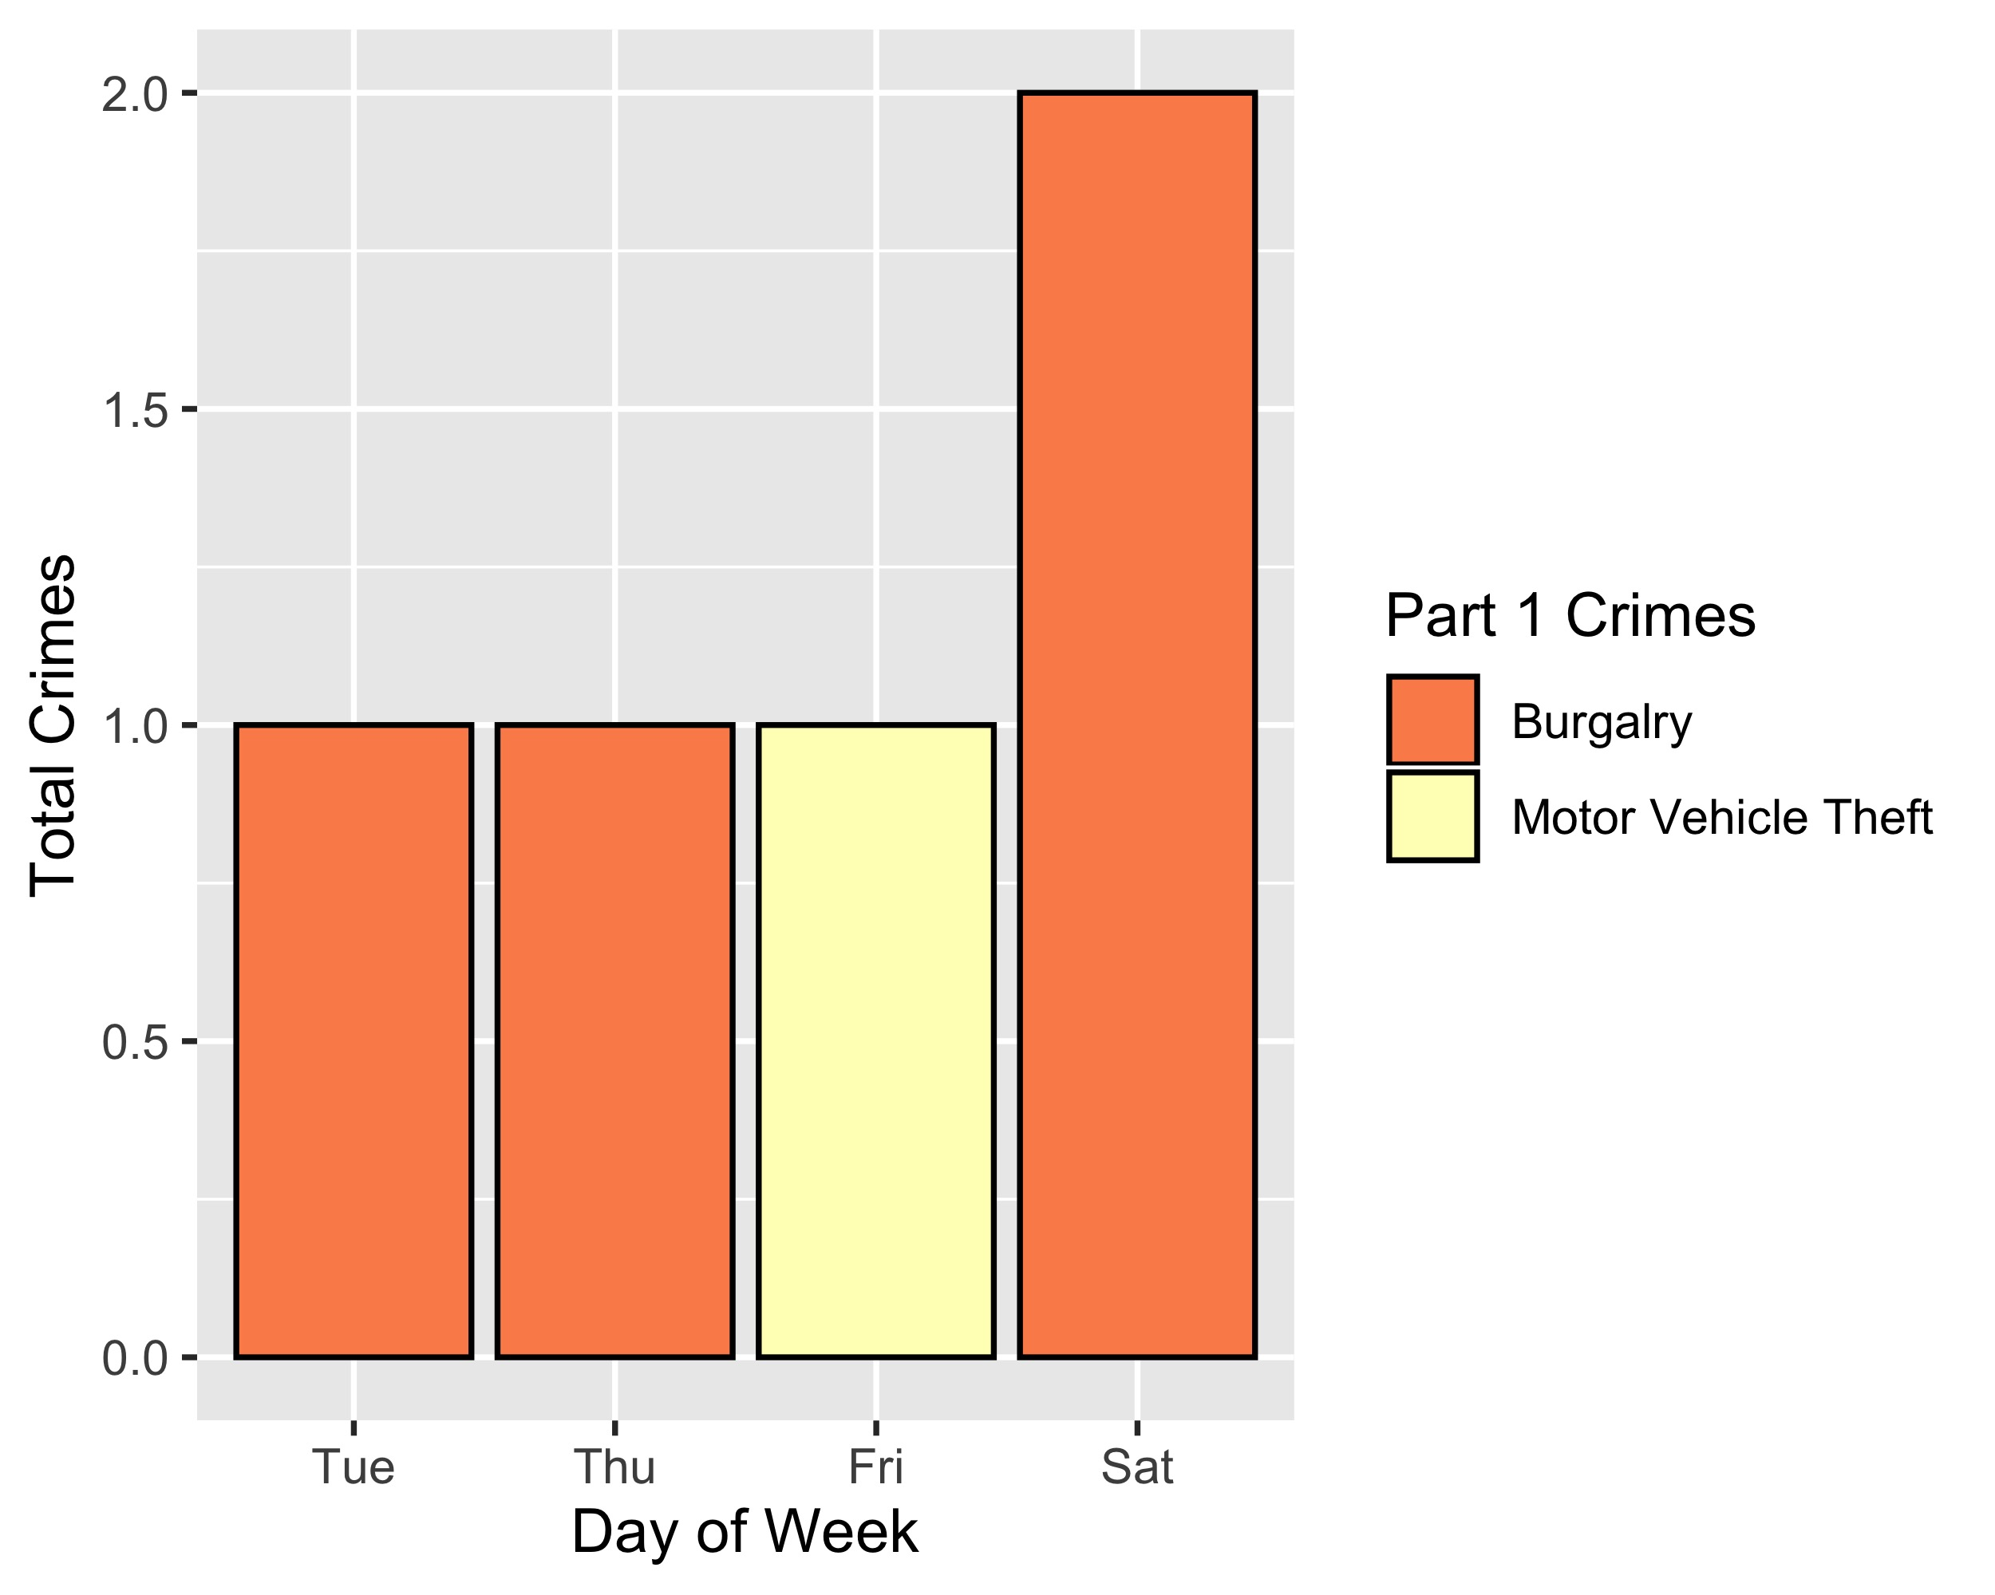
Lewis Place: Crimes by Day & Category

Slide 44
Vandeventer: Neighborhood Detail
Appendix 4

Slide 45
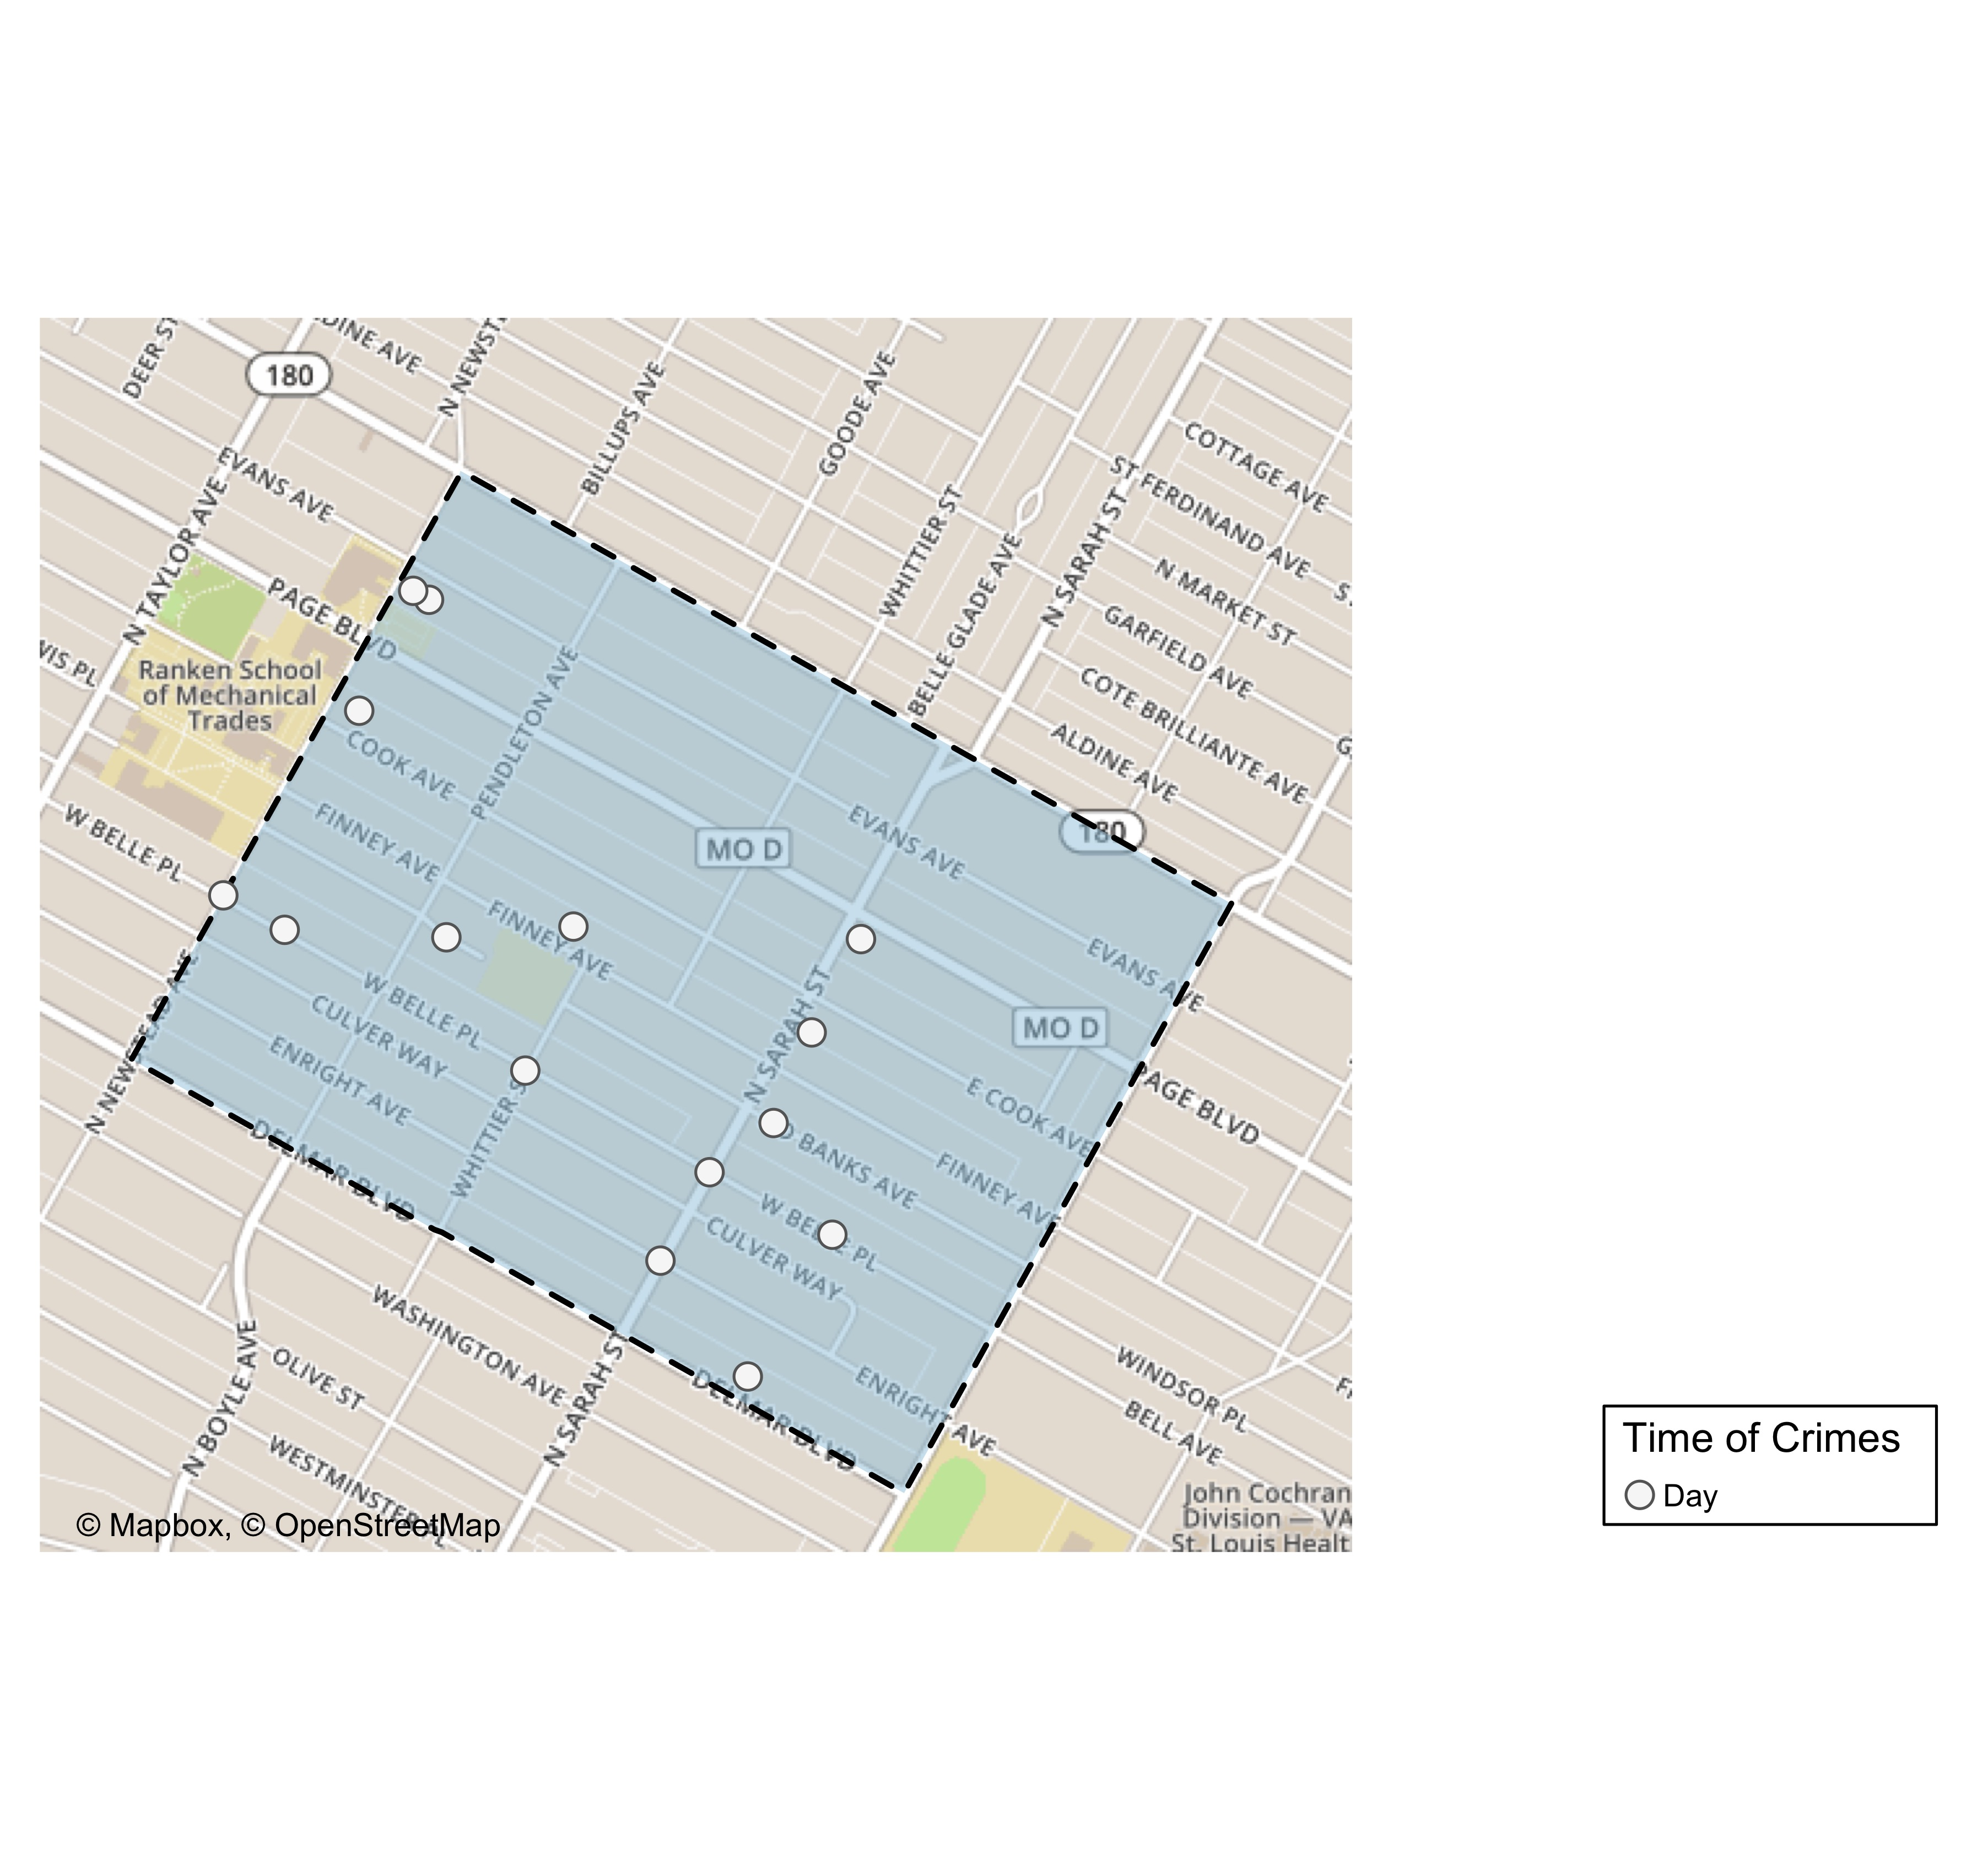
Vandeventer: Time of Crimes Map

Slide 46
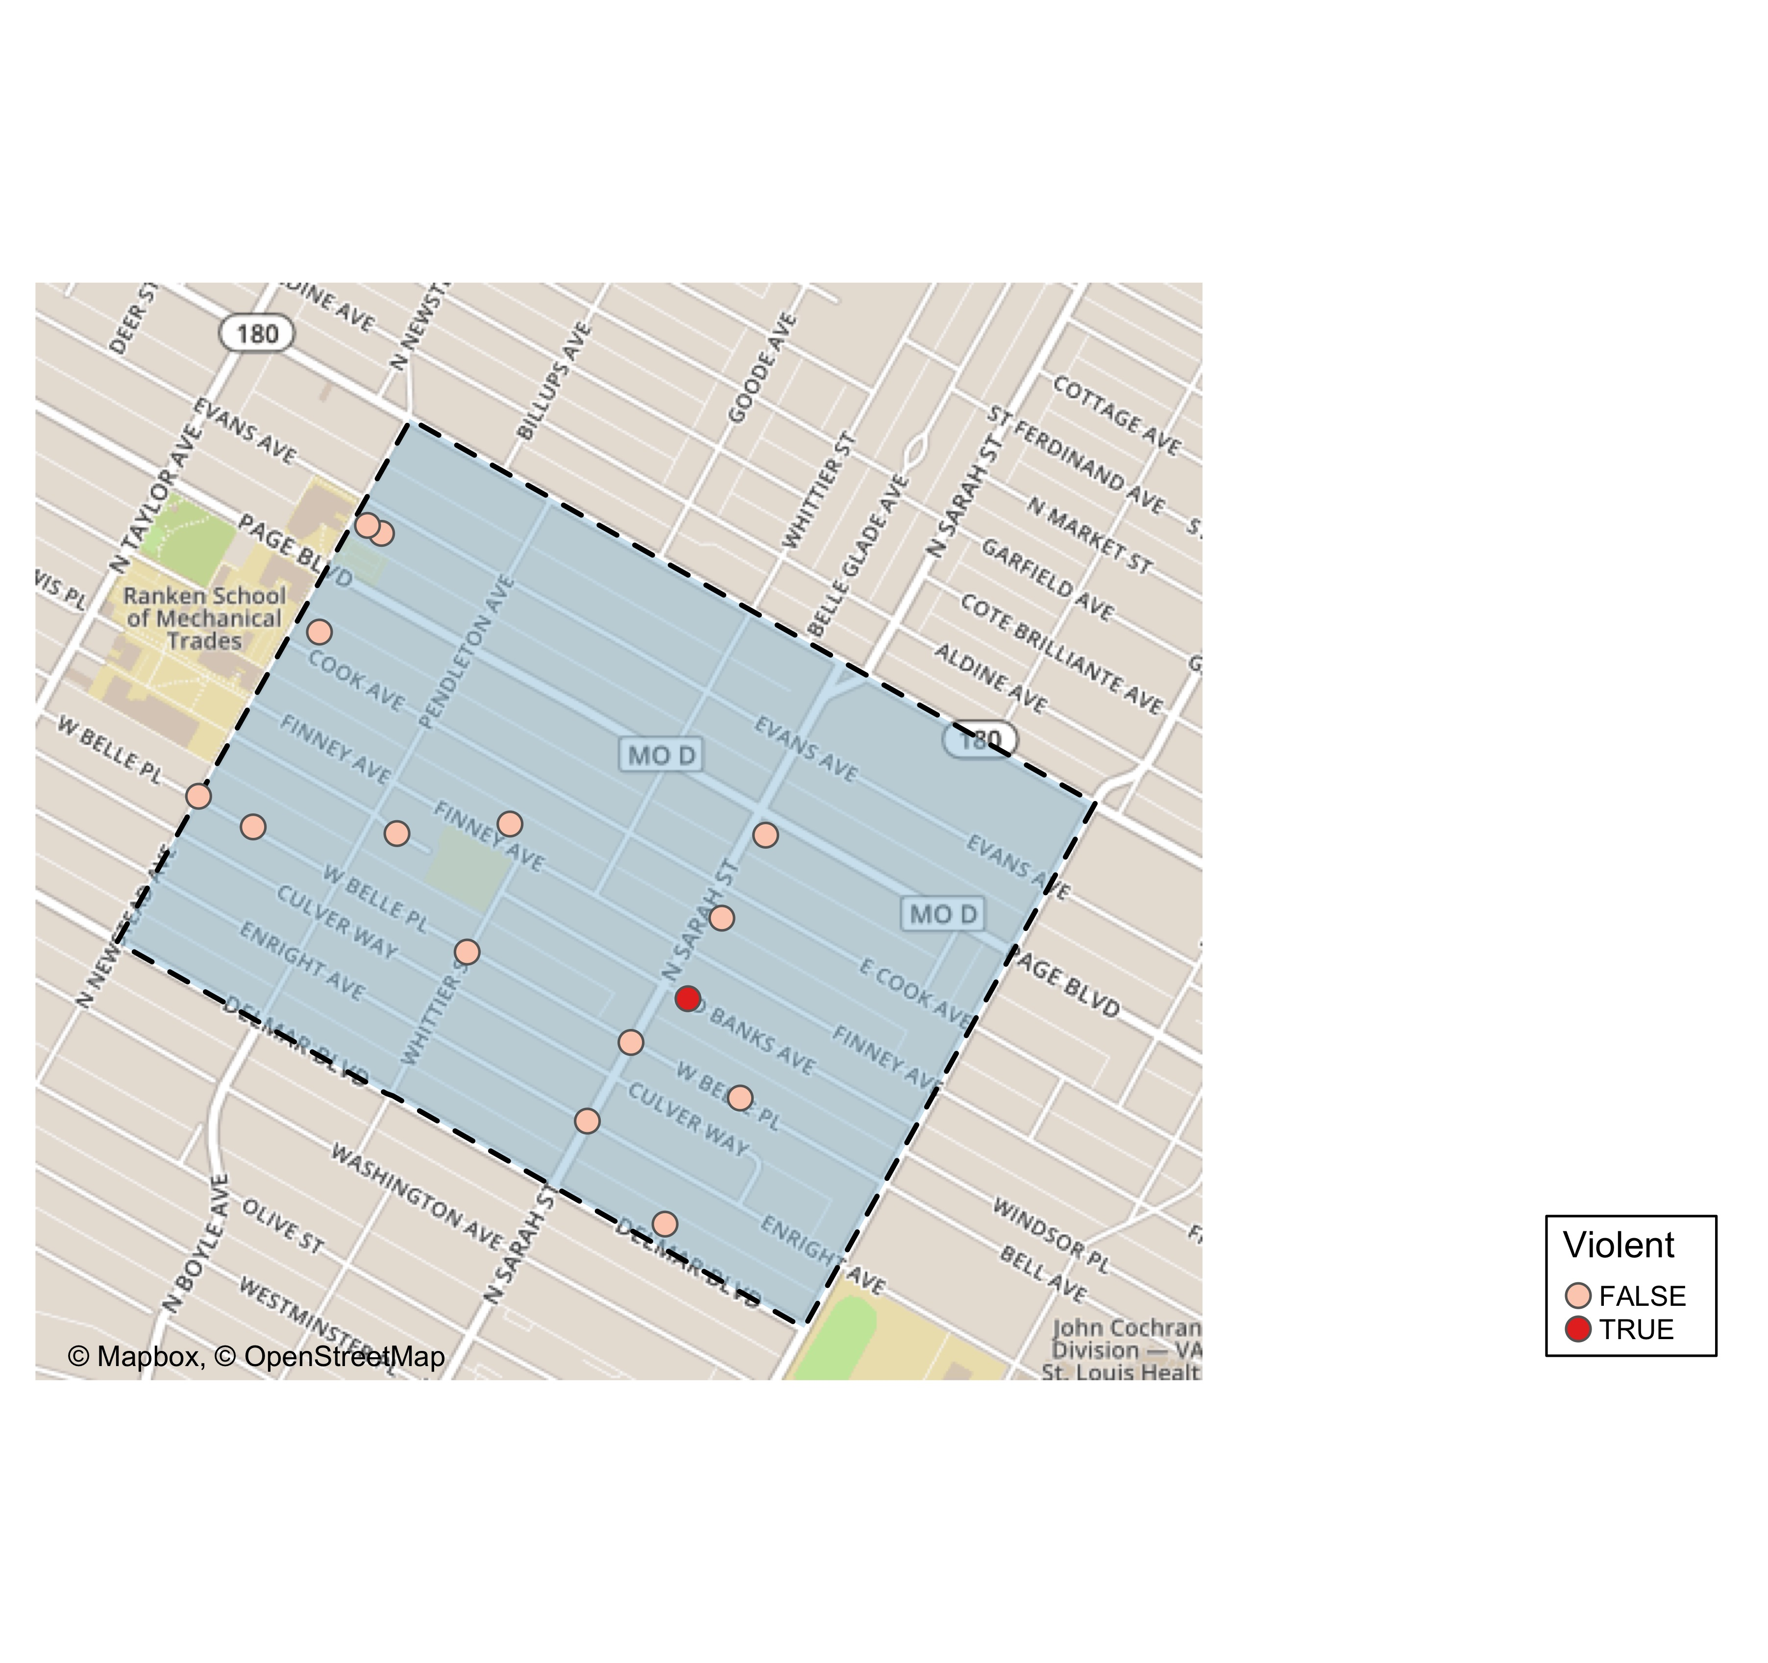
Vandeventer: Violent Crime Map

Slide 47
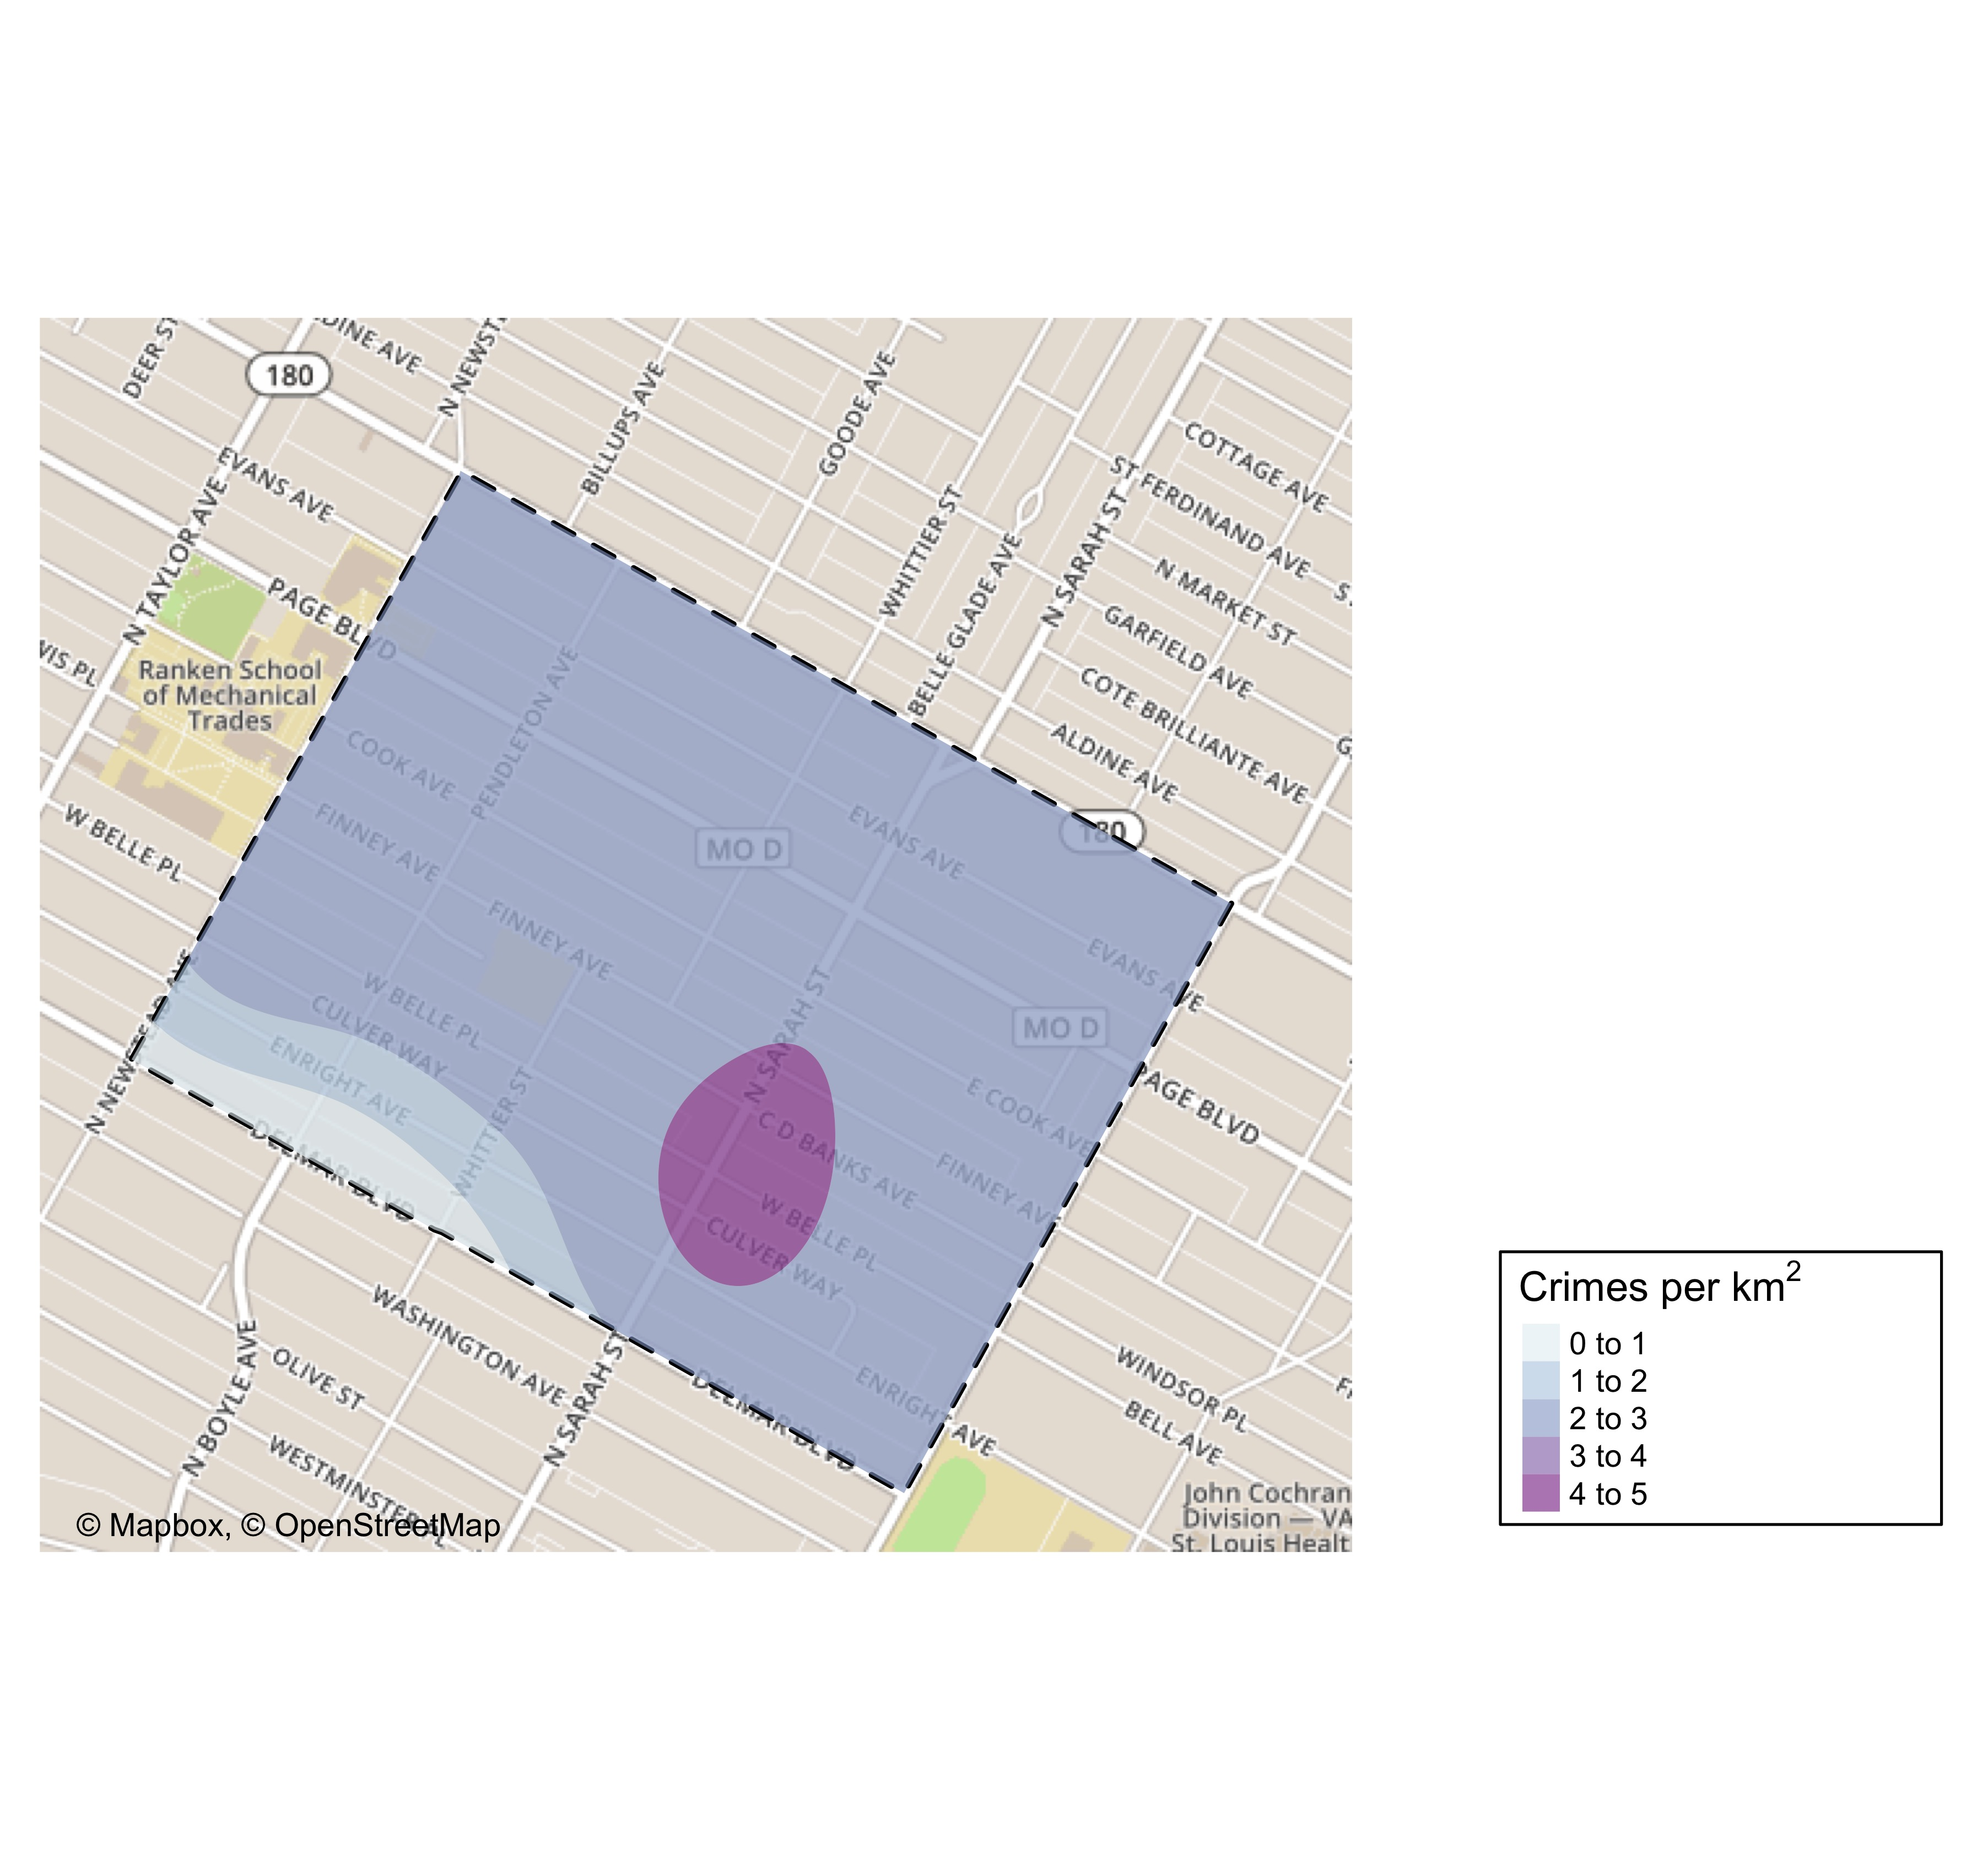
Vandeventer: Crime Density Map

Slide 48
Vandeventer: Larceny Breakdown
Day of the Week | Number of Crimes
Sun | 1
Mon | 1
Tue | 2
Wed | 2
Thu | 1
Fri | 1
Total | 8
Time of Day | Number of Crimes
Day | 8
Total | 8
Type of Larceny | Number of Crimes
All Other | 6
From Building | 1
From Motor Vehicle | 1
Total | 8
Monetary | Number of Crimes
$500 - $24,999 | 5
Under $500 | 3
Total | 8

Slide 49
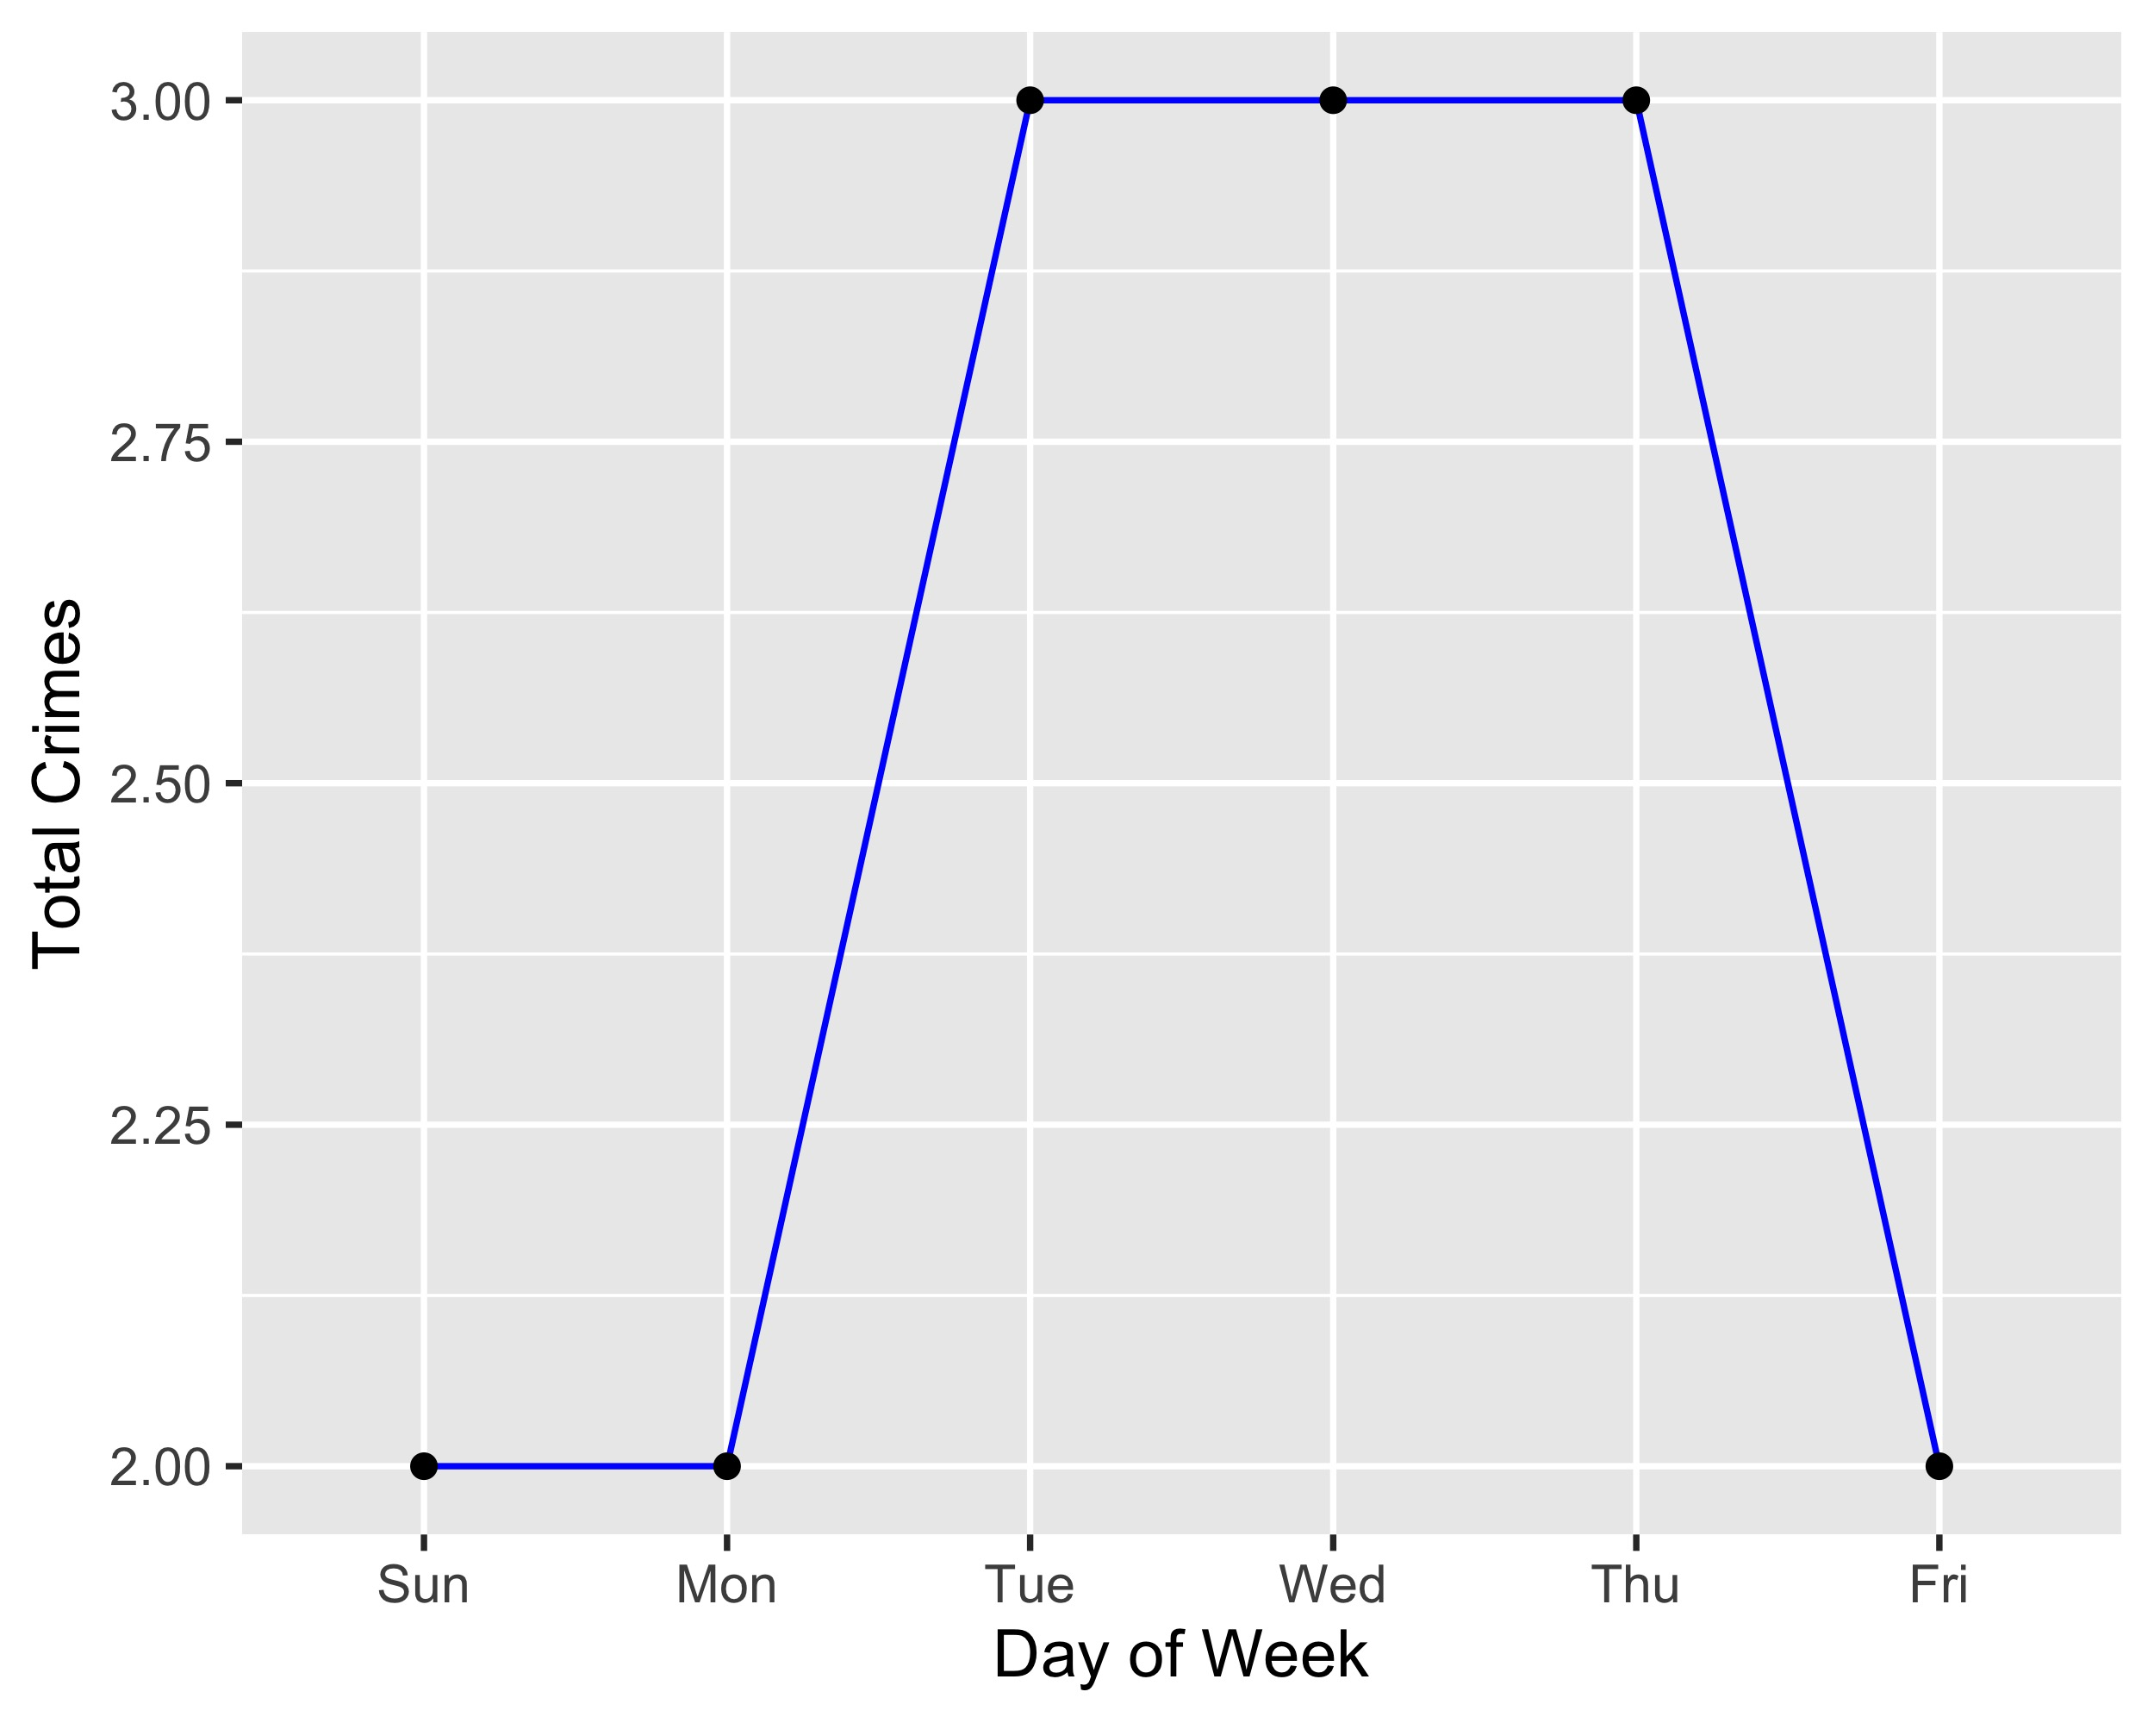
Vandeventer: Total Crimes by Days of the Week

Slide 50
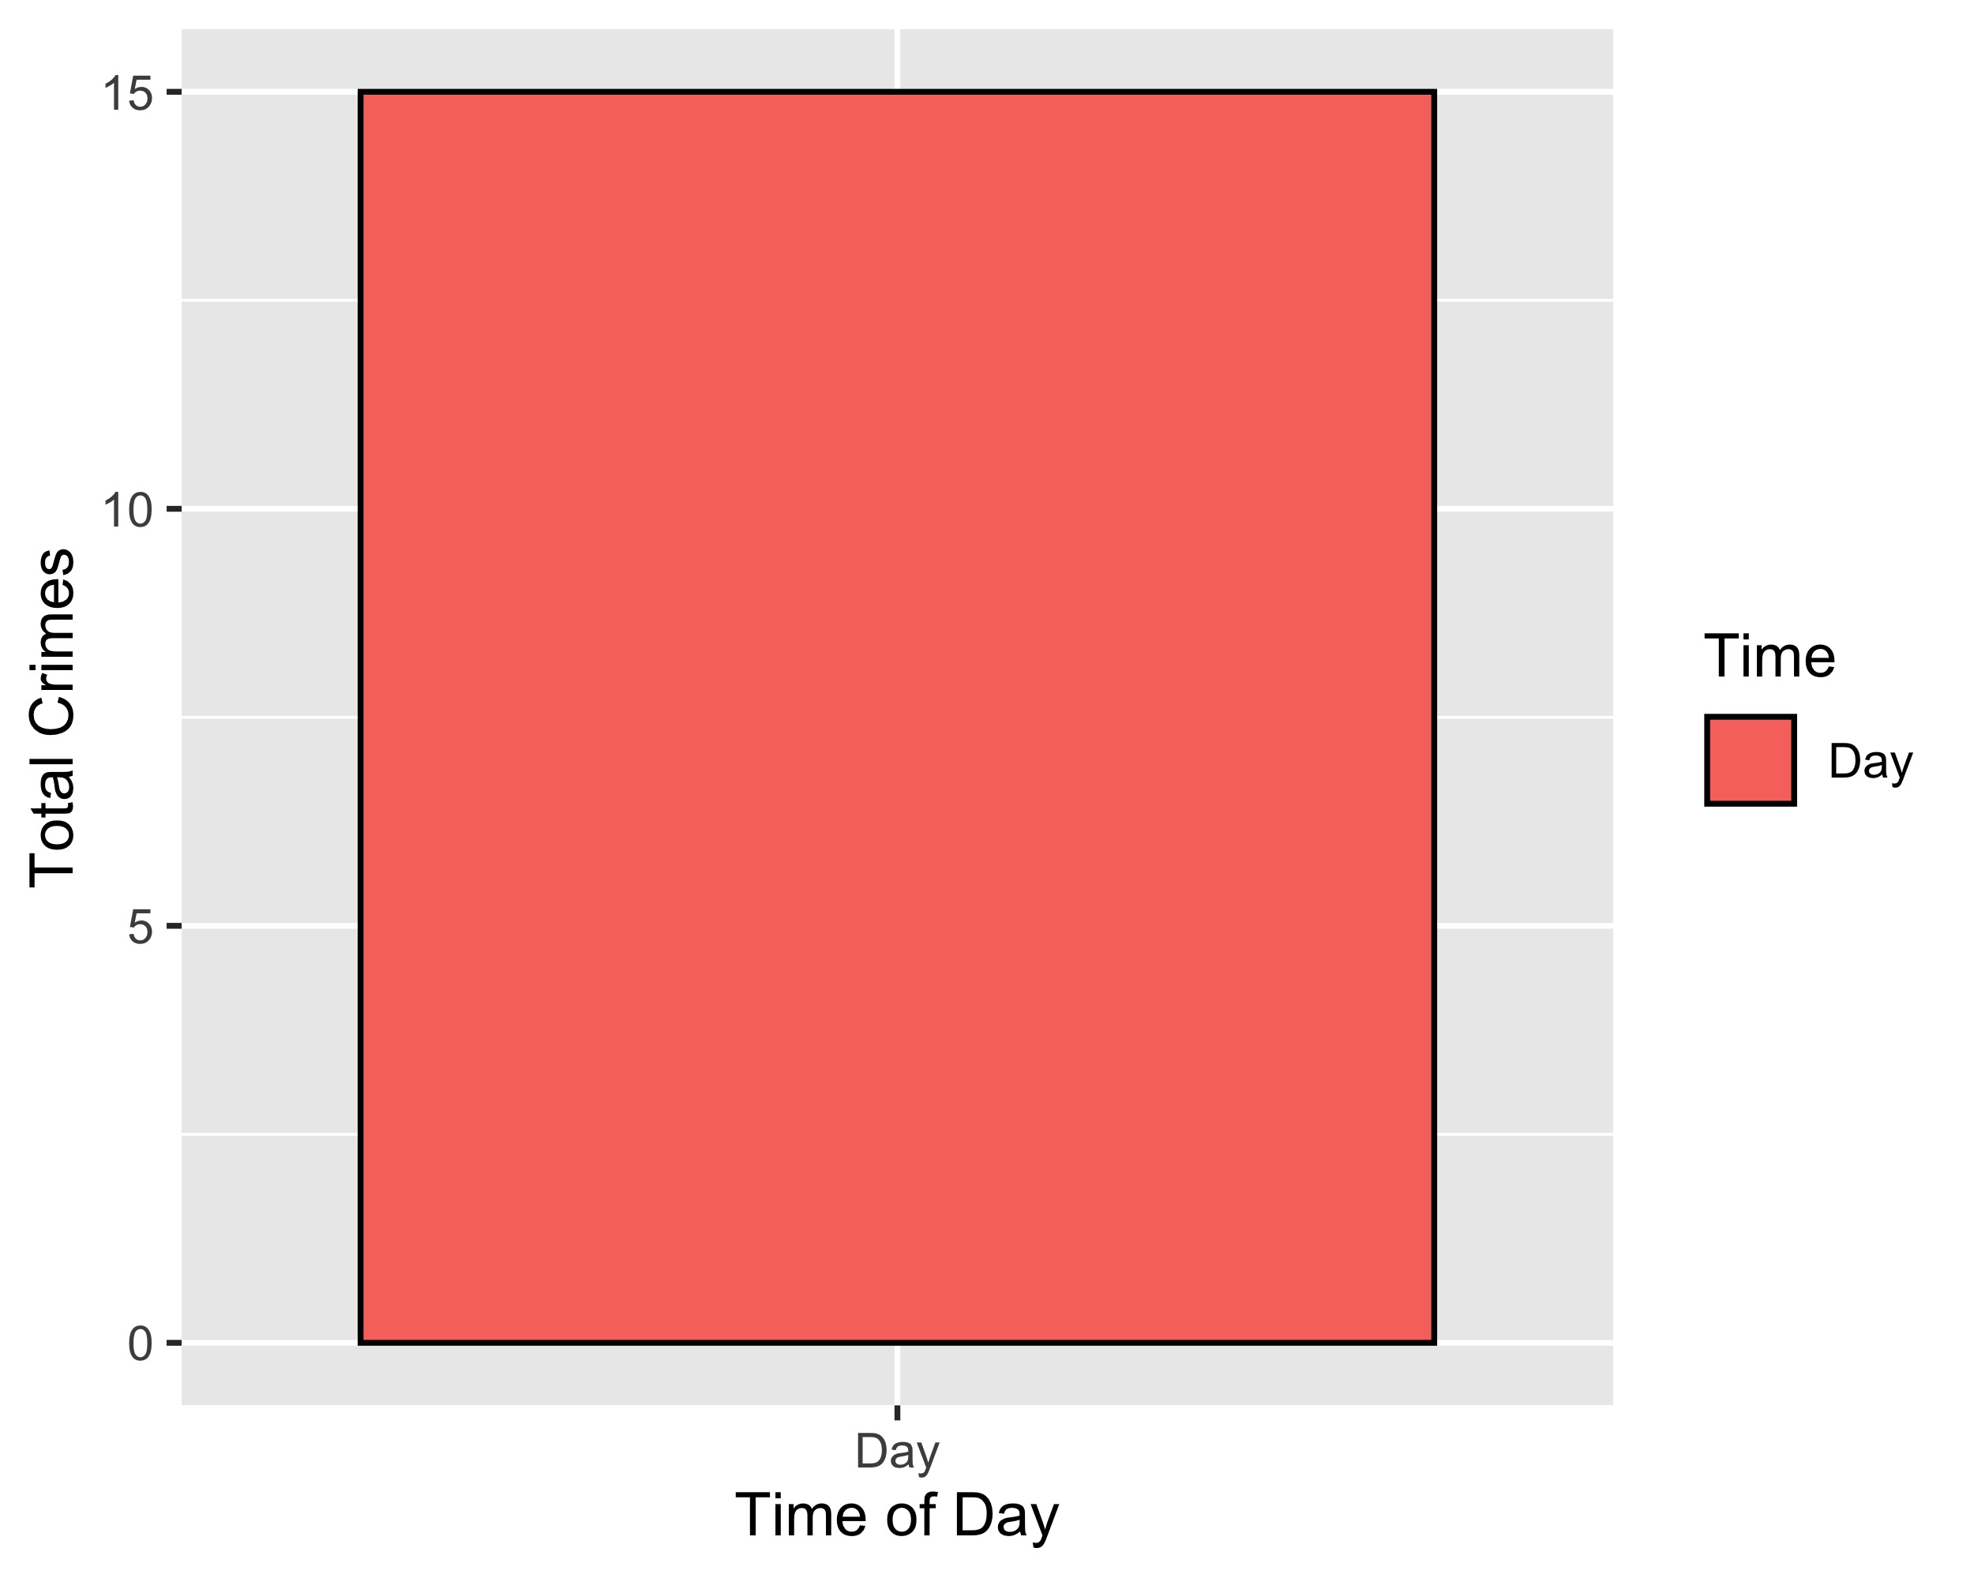
Vandeventer: Crimes by Time of Day

Slide 51
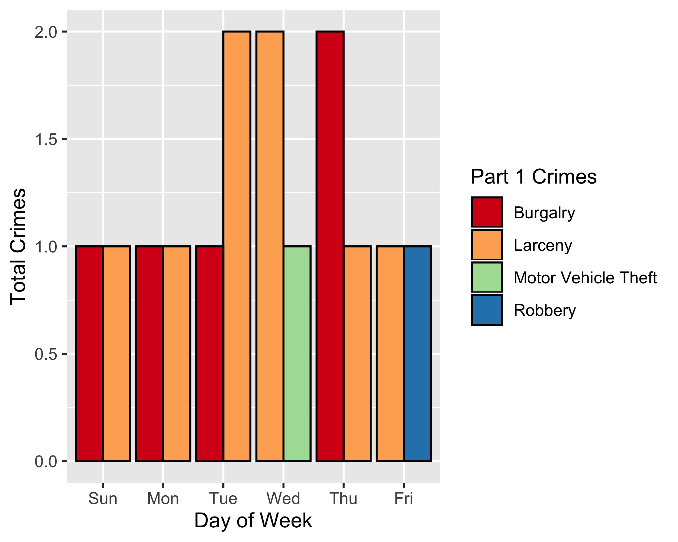
Vandeventer: Crimes by Day & Category

